Slide 1
Spring 2026 New Titles
Rick Beale, Capstone VA Representative

Slide 2
Spring 2026 New Products and Key Themes
NEW IMPRINT
Capstone Value Library
250th Anniversary
Declaration of Independence
Navigating Our World in 2026
Spotlight on Sports
Literacy Supports and Hi-Lo
Character Education
Cute vs Gross
Mirrors and Windows
Not Your Ordinary Nonfiction
Kids Being Kids
Extensions
Spanish Conversions

Slide 3
Introducing -
Capstone Value Library

Slide 4
Essential Nonfiction at an Exceptional Value
Providing a budget-friendly way for educators to refresh their collections
with straightforward, reliable nonfiction that supports science and
social studies standards.
Spring 2026 – 37 titles
Fall 2026 – 36 titles
Specifications: 7 x 9, 24 pages
Formats: HC, CI, eBooks

Slide 5
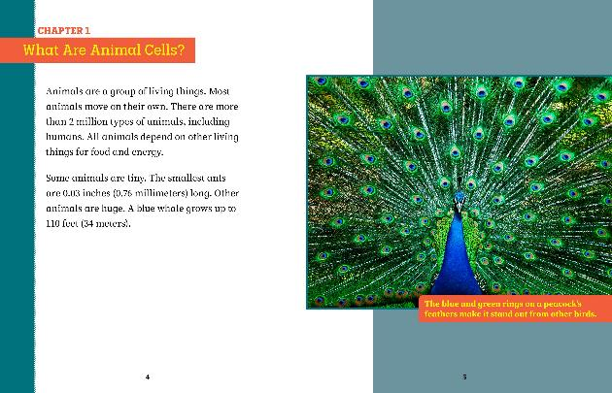
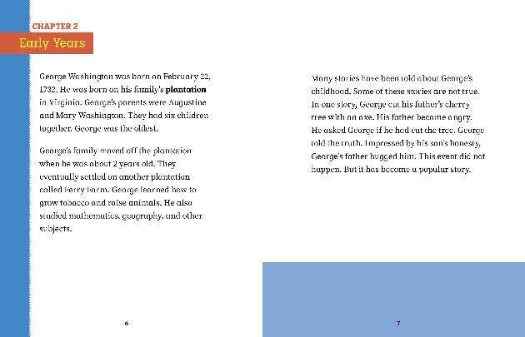
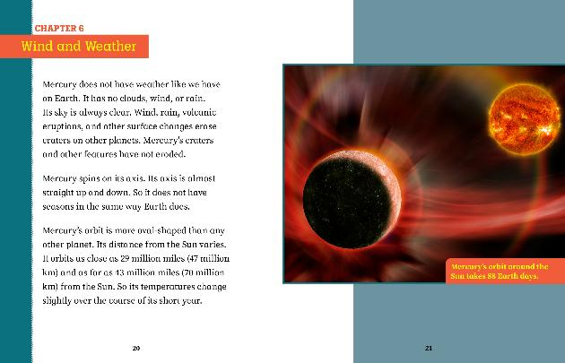
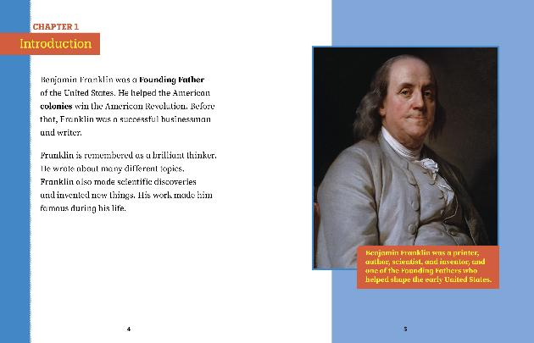
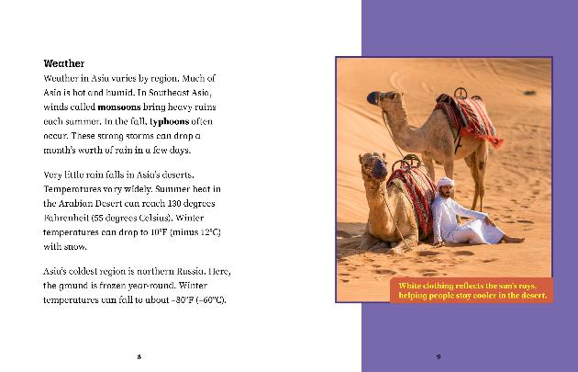
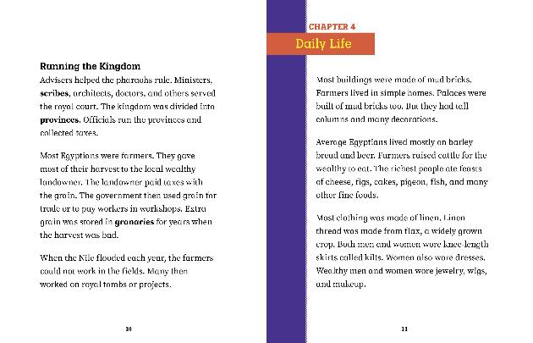
Streamlined design features dynamic photos and accessible text

Slide 6
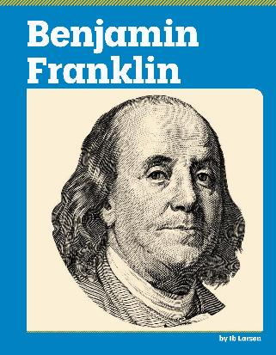





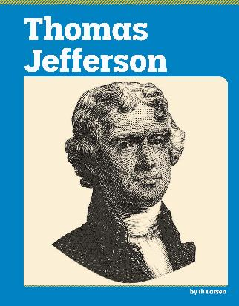
NEW SERIES
American Revolution Biographies
Interest Level: 3 - 5
Reading Level: 3 - 4
Trim Size: 7’’ x 9’’
Page Count: 24
S/L Price Hardcover: $14.99
KEY FEATURES:
Capstone Value Library delivers clear, concise nonfiction at the lowest possible price, so budgets go further without sacrificing quality
Reliable, curriculum-aligned nonfiction that librarians and students can trust
Straightforward treatments of essential social studies topics that support state and national standards
Available
for Capstone Interactive!
Spring 26 Catalog page 69

Slide 7

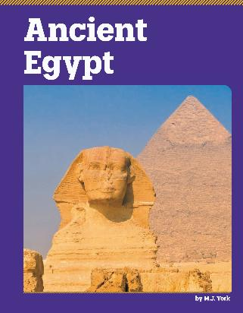


NEW SERIES
Discover Ancient Civilizations
Interest Level: 3 - 5
Reading Level: 3 - 4
Trim Size: 7’’ x 9’’
Page Count: 24
S/L Price Hardcover: $14.99
KEY FEATURES:
Capstone Value Library delivers clear, concise nonfiction at the lowest possible price, so budgets go further without sacrificing quality
Reliable, curriculum-aligned nonfiction that librarians and students can trust
Straightforward treatments of essential social studies topics that support state and national standards
Available
for Capstone Interactive!
Spring 26 Catalog page 68

Slide 8







NEW SERIES
The Continents
Interest Level: 3 - 5
Reading Level: 3 - 4
Trim Size: 7’’ x 9’’
Page Count: 24
S/L Price Hardcover: $14.99
KEY FEATURES:
Capstone Value Library delivers clear, concise nonfiction at the lowest possible price, so budgets go further without sacrificing quality
Reliable, curriculum-aligned nonfiction that librarians and students can trust
Straightforward treatments of essential social studies topics that support state and national standards
Available
for Capstone Interactive!
Spring 26 Catalog page 69

Slide 9




NEW SERIES
Exploring Life Science
Interest Level: 3 - 5
Reading Level: 3 - 4
Trim Size: 7’’ x 9’’
Page Count: 24
S/L Price Hardcover: $14.99
KEY FEATURES:
Capstone Value Library delivers clear, concise nonfiction at the lowest possible price, so budgets go further without sacrificing quality
Reliable, curriculum-aligned nonfiction that librarians and students can trust
Straightforward treatments of essential social studies topics that support state and national standards
Available
for Capstone Interactive!
Spring 26 Catalog page 67

Slide 10

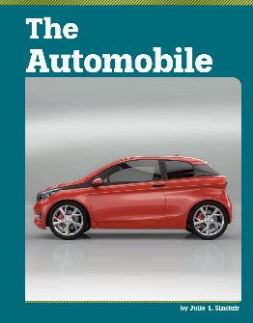
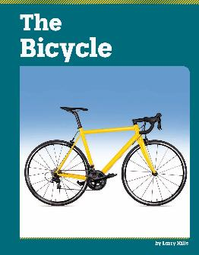
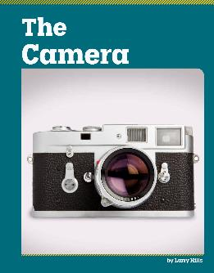



NEW SERIES
Famous Inventions
Interest Level: 3 - 5
Reading Level: 3 - 4
Trim Size: 7’’ x 9’’
Page Count: 24
S/L Price Hardcover: $14.99
KEY FEATURES:
Capstone Value Library delivers clear, concise nonfiction at the lowest possible price, so budgets go further without sacrificing quality
Reliable, curriculum-aligned nonfiction that librarians and students can trust
Straightforward treatments of essential social studies topics that support state and national standards
Available
for Capstone Interactive!
Spring 26 Catalog page 68

Slide 11
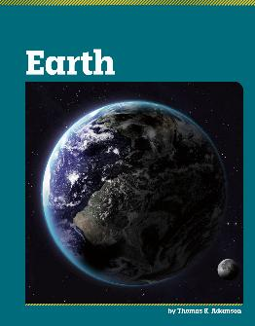
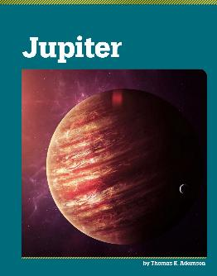
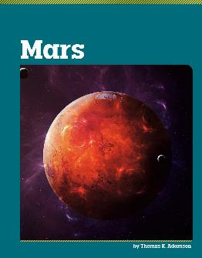
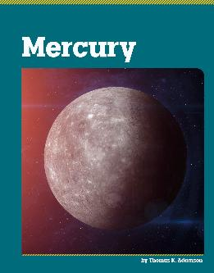
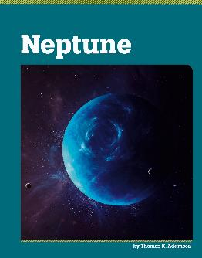
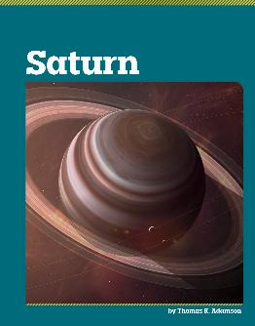

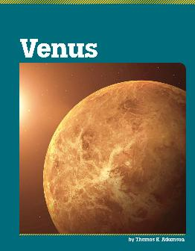
NEW SERIES
The Planets
Interest Level: 3 - 5
Reading Level: 3 - 4
Trim Size: 7’’ x 9’’
Page Count: 24
S/L Price Hardcover: $14.99
KEY FEATURES:
Capstone Value Library delivers clear, concise nonfiction at the lowest possible price, so budgets go further without sacrificing quality
Reliable, curriculum-aligned nonfiction that librarians and students can trust
Straightforward treatments of essential social studies topics that support state and national standards
Available
for Capstone Interactive!
Spring 26 Catalog page 67

Slide 12
250th Anniversary –
Declaration of Independence

Slide 13

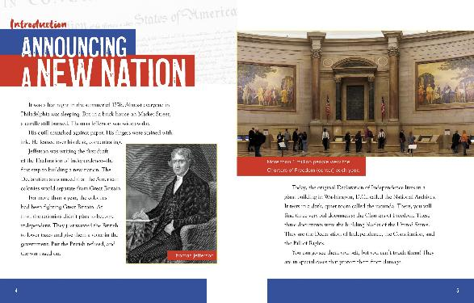

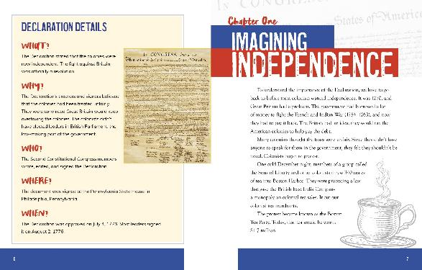
NEW TITLE
The Declaration of Independence
The Daring Document That Founded a New Nation
Interest Level: 3 – 5
Reading Level: 3 – 5
Trim Size: 8’’ x 10''
Page Count: 32
S/L Price Hardcover: $23.49
S/L Price Paperback: $9.99
KEY FEATURES:
Fresh perspective on the Declaration of Independence that coincides with the 250th anniversary of its signing
Helps young readers understanding this historic document and its importance past, present, and future
Supports state and national social studies standards while promoting critical thinking about historical events and primary sources
Available
for Capstone Interactive!
Spring 26 Catalog page 49

Slide 14

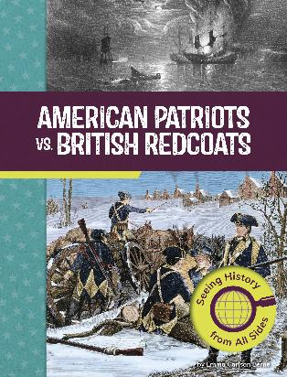

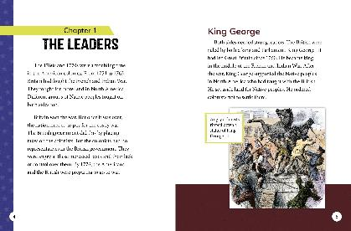
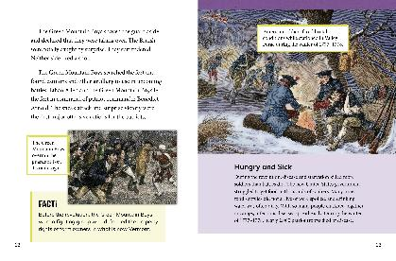

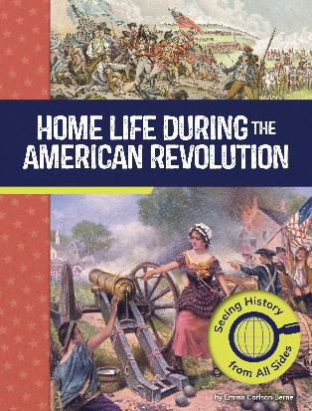
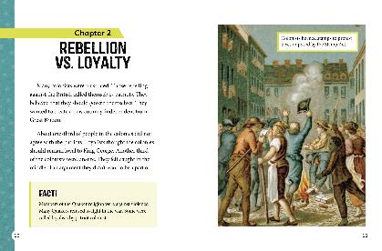
NEW SERIES
American Revolutionary War Perspectives
Interest Level: 3 - 5
Reading Level: 3 - 4
Trim Size: 7’’ x 9’’
Page Count: 32
S/L Price Hardcover: $23.49
S/L Price Paperback: $8.99
KEY FEATURES:
Provides multiple perspectives on the American Revolutionary War, helping readers understand how these events affected different groups of people
Supports state and national social studies standards
Infographics such as charts and maps convey information in an engaging way
Available
for Capstone Interactive!
Spring 26 Catalog page 52

Slide 15





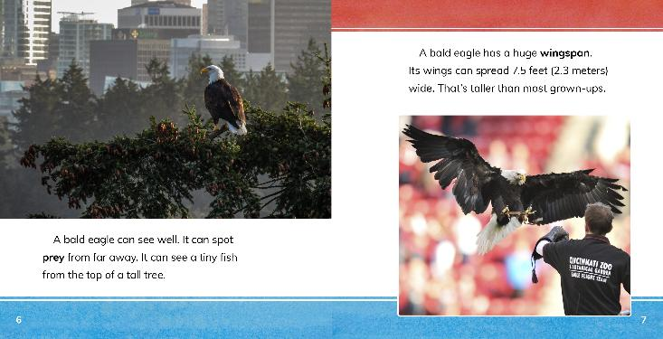
NEW SERIES
Symbols of America
Interest Level: K – 3
Reading Level: 1 – 2
Trim Size: 8’’ x 10’’
Page Count: 24
S/L Price Hardcover: $22.49
S/L Price Paperback: $9.99
KEY FEATURES:
Provides simple, age-appropriate introductions to key national symbols, explaining their origins and ongoing significance
Perfect supports for social studies curriculum standards related to U.S. history, national symbols, and historical figures
Historical photographs help bring the origins of each symbol to life
Available
for Capstone Interactive!
Spring 26 Catalog page 35

Slide 16
Navigating Our World
in 2026

Slide 17

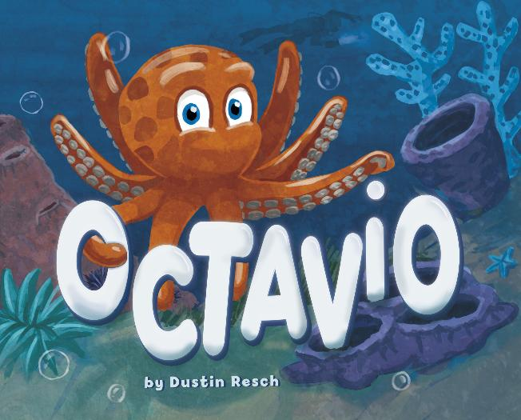
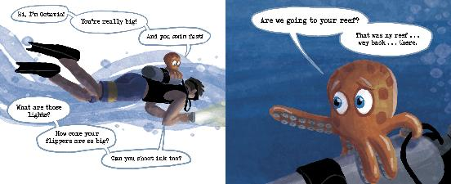
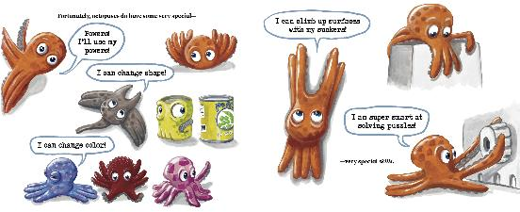
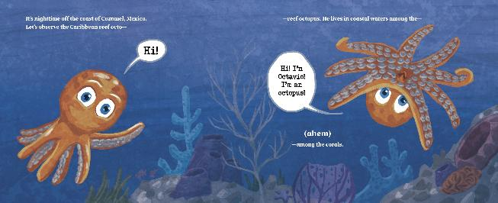
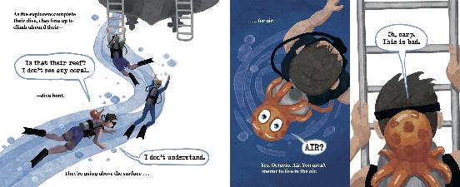
NEW TITLE
Octavio
Interest Level: K – 3
Reading Level: 1 – 3
Trim Size: 10’’ x 8''
Page Count: 32
S/L Price Hardcover: $18.99
KEY FEATURES:
Fun octopus' facts are woven into an accessible and humorous story, paired with a fun and engaging art style
Octopuses are popular, especially following My Octopus Teacher, Squishmallows, Minecraft, and viral videos of octopuses
Mockumentary storytelling style is a fun nod to popular nature documentaries and offers an effective delivery of facts with humor
Dustin Resch is a scuba diver and debut children’s author/illustrator
Available
for Capstone Interactive!
Spring 26 Catalog page 14

Slide 18

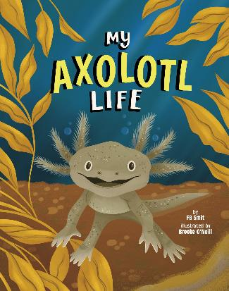
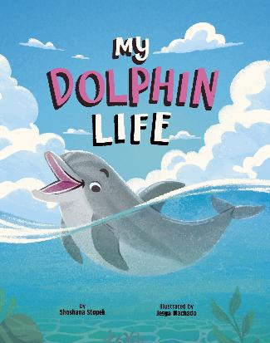
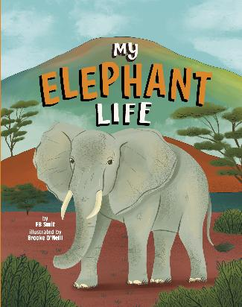

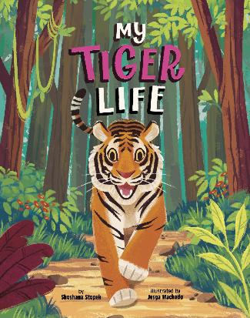
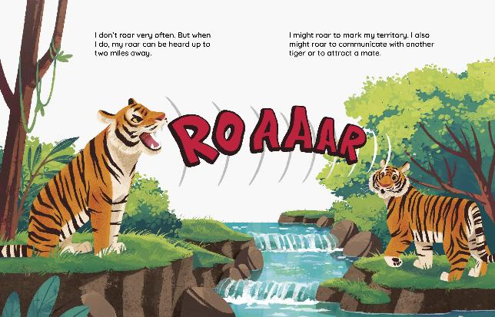
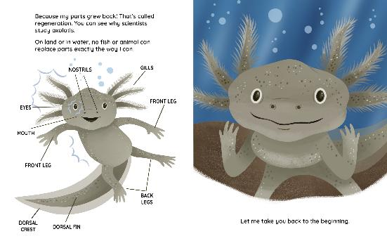
NEW SERIES
Animal Perspectives
Interest Level: K – 3
Reading Level: K – 2
Trim Size: 8’’ x 10’’
Page Count: 32
S/L Price Hardcover: $ 20.49
S/L Price Paperback: $9.99
KEY FEATURES:
Stories told from the animals' point of view
Introduces core life science concepts
Interactive text is perfect for reading aloud
Available
for Capstone Interactive!
Spring 26 Catalog page 23

Slide 19





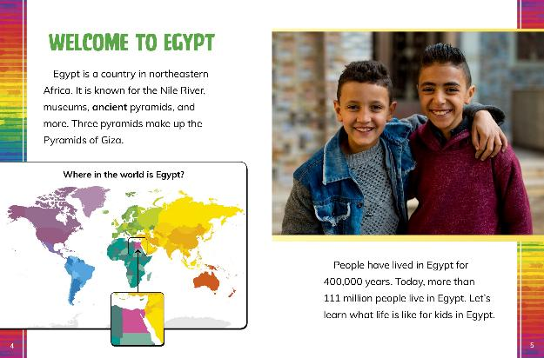
NEW SERIES
Kids Around the World
Interest Level: K - 3
Reading Level: 2 - 3
Trim Size: 7’’ x 9’’
Page Count: 32
S/L Price Hardcover: $23.49
S/L Price Paperback: $8.99
KEY FEATURES:
Unique look at countries with a focus on the lives of children makes for a high-interest approach
Supports Social Studies standards relating to culture, people and places, economics, and global connections
Introduces children to varied cultures throughout the world, broadening their understanding of how people are both similar and different worldwide
Available
for Capstone Interactive!
Spring 26 Catalog page 38

Slide 20


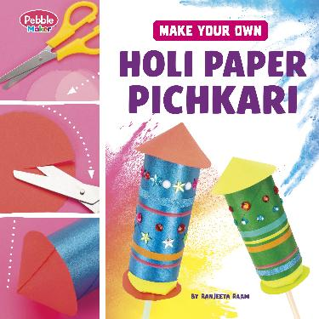
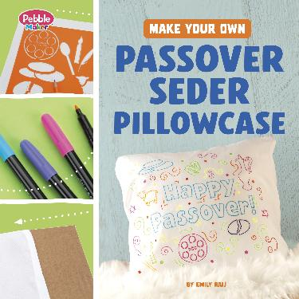
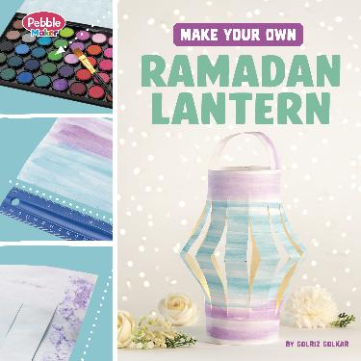
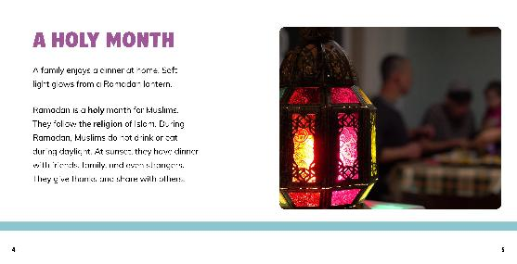
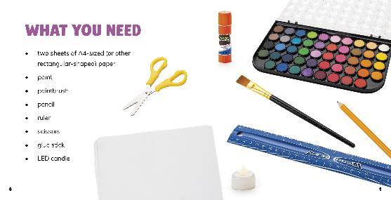
NEW SERIES
Pebble Maker Crafts for Traditions and Celebrations
Interest Level: K - 3
Reading Level: 1 – 2
Trim Size: 8’’ x 8’’
Page Count: 24
S/L Price Hardcover: $22.49
KEY FEATURES:
Projects involve simple steps and require little to no adult assistance
Perfect introductions to procedural texts with straightforward step-by-step instructions that are accompanied by clear photographs
A fun way to introduce kids to holidays and festivals celebrated by people from different religious and cultural backgrounds
Available
for Capstone Interactive!
Spring 26 Catalog page 36

Slide 21

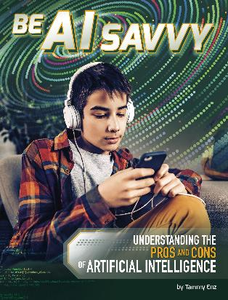


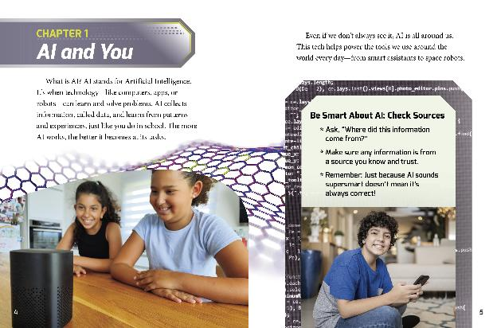
NEW SERIES
AI and Your World
Interest Level: 3 - 5
Reading Level: 3 - 4
Trim Size: 7’’ x 9’’
Page Count: 32
S/L Price Hardcover: $23.49
S/L Price Paperback: $8.99
KEY FEATURES:
High-interest, detailed look at artificial intelligence and how it impacts daily life around the world
Helps young readers see the potential and pitfalls of digital tools in addressing real-world issues and problems
Provides critical thinking tools for kids to evaluate digital content and solutions
Available
for Capstone Interactive!
Spring 26 Catalog page 52

Slide 22

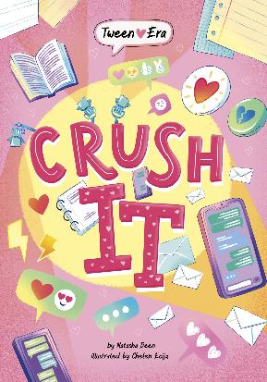

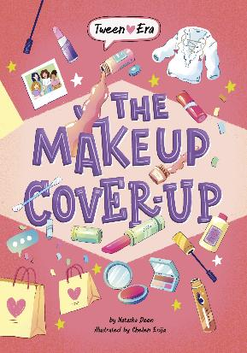
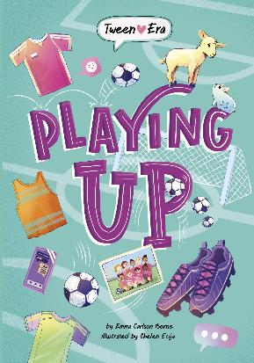
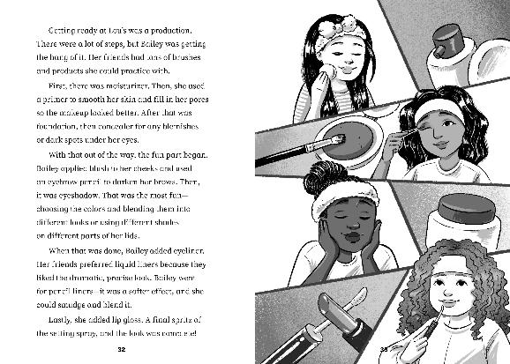
NEW SERIES
Tween Era
Interest Level: 3 - 6
Reading Level: 3 - 5
Trim Size: 5 1/4’’ x 7 1/2’’
Page Count: 72
S/L Price Hardcover: $19.49
S/L Price Paperback: $8.99
KEY FEATURES:
Embodies the lighthearted, realistic fiction genre currently trending among middle grade readers
Covers relevant and timely topics including body image, social media, peer pressure, friendships, relationships, puberty, and more
A variety of identities in standalone texts showcases diverse stories and experiences
Available
for Capstone Interactive!
Spring 26 Catalog page 63

Slide 23
Spotlight on Sports

Slide 24


EXTENDED SERIES
Time to Play Soccer!
Interest Level: PreK – 2
Reading Level: PreK – 2
Trim Size: 10'' x 8 1/2’’
Page Count: 32
S/L Price Hardcover: $18.99
KEY FEATURES:
Engaging storytelling conveys both individual achievements and the importance of teamwork during early sports experiences
Promotes key social and emotional themes of perseverance, fairness, cooperation, and more through sports participation
Created in partnership with Sports Illustrated Kids
Available
for Capstone Interactive!
Spring 26 Catalog page 17

Slide 25







NEW SERIES
World Cup Soccer
Interest Level: 3 - 5
Reading Level: 3 - 4
Trim Size: 7’’ x 9’’
Page Count: 32
S/L Price Hardcover: $23.49
S/L Price Paperback: $8.99
KEY FEATURES:
The popularity of youth soccer continues to grow in the United States with about 2.5 million kids ages 6-12 playing in youth soccer leagues, according to the U.S. Youth Soccer Association
The 2022 FIFA World Cup men’s final attracted 1.5 billion viewers around the globe, making it the most watched sporting event in FIFA history—and beating viewership for the Super Bowl that year
Exploring the World Cup's past, present, and future offers readers an international perspective on the world's most popular sport
Available
for Capstone Interactive!
Spring 26 Catalog page 51

Slide 26




EXTENDED SERIES
Shohei Ohtani: Baseball Trailblazer
Sports Illustrated Kids: Stars of Sports
Interest Level: 3 - 5
Reading Level: 3 - 4
Trim Size: 7’’ x 9’’
Page Count: 32
S/L Price Hardcover: $23.49
S/L Price Paperback: $8.99
CI and eBooks
KEY FEATURES:
Includes all the action-packed highlights from the 2025 Major League Baseball Championship series!
In partnership with Sports Illustrated Kids, an elite sports magazine offering a kid-first perspective to 7+ million young sports fans.
Full of action and impactful details, these are biographies kids want to read.
REVISED EDITION!
Spring 26 Catalog page 47

Slide 27






NEW SERIES
Sports Are the Best!
Interest Level: K - 3
Reading Level: 2 - 3
Trim Size: 7’’ x 9’’
Page Count: 32
S/L Price Hardcover: $23.49
S/L Price Paperback: $8.99
KEY FEATURES:
Packed with age-appropriate information to help kids gain foundational knowledge about their favorite sports
Promotes critical thinking skills for young readers by helping them to compare different sports
Each book includes a fun quiz to help reinforce learning
Available
for Capstone Interactive!
Spring 26 Catalog page 36

Slide 28







NEW SERIES
Snowboarding Blast
Interest Level: 4 - 6
Reading Level: 2 - 3
Trim Size: 7’’ x 9’’
Page Count: 32
S/L Price Hardcover: $23.49
S/L Price Paperback: $8.99
KEY FEATURES:
Snowboarding is increasingly popular among young athletes, with Snowsports Industries America reporting that approximately one-third of snowboarders in the United States are ages 17 and under
Hi-lo text written to support and engage striving and reluctant readers
Text features support Science of Reading principles of comprehension and vocabulary development
Available
for Capstone Interactive!
Spring 26 Catalog page 58

Slide 29







NEW SERIES
Sports Illustrated Kids: Would You Rather?
Interest Level: K – 2
Reading Level: K – 2
Trim Size: 6’’ x 9’’
Page Count: 32
S/L Price Hardcover: $16.99
S/L Price Paperback: $7.99
KEY FEATURES:
Brain Candy Books promise to meet kids where they are—with topics kids love learning and talking about, and high-appeal formats to keep readers coming back for more
Published in partnership with Sports Illustrated Kids, an elite sports magazine offering a kid-first perspective to 7+ million young sports fans
Kid-favorite "would you rather?" format prompts kids with pro sports-related scenarios that will have them reading for the pure fun of it
Special feature boxes add details that kids may not have considered while making their original choice, flexing kids' critical thinking skills
Available
for Capstone Interactive!
Spring 26 Catalog page 43

Slide 30






NEW SERIES
Sports Illustrated Kids: You Make the Call!
Interest Level: 3 - 5
Reading Level: 3 - 4
Trim Size: 7’’ x 9’’
Page Count: 32
S/L Price Hardcover: $23.49
S/L Price Paperback: $8.99
KEY FEATURES:
Created in partnership with Sports Illustrated Kids, an elite sports magazine offering a kid-first perspective to 7+ million young sports fans
Kids flex their critical thinking skills by analyzing controversial game-changing calls
Text provides insight into the role of officials and referees and their importance in pro sports
Dynamic photos showcase the action behind popular plays and help readers debate and discuss the outcome
Available
for Capstone Interactive!
Spring 26 Catalog page 51

Slide 31
Literary Supports and Hi-Lo

Slide 32




NEW TITLE
How to Teach Your Monster the ABCs
Interest Level: PreK – 1
Reading Level: K – 2
Trim Size: 8’’ x 10''
Page Count: 32
S/L Price Hardcover: $18.99
KEY FEATURES:
Provides a Science of Reading tie-in to classroom and home reading
Promotes early reading skills in a humorous and light-hearted picture book format
Award-winning children's book author Christianne Jones uses humor and charm to delight children and grown-ups alike
Perfect for fans of the Do Not Take Your Dragon series
Available
for Capstone Interactive!
Spring 26 Catalog page 11

Slide 33





NEW SERIES
Mythical Matchups
Interest Level: 4 - 6
Reading Level: 2 - 3
Trim Size: 7’’ x 9’’
Page Count: 32
S/L Price Hardcover: $23.49
S/L Price Paperback: $8.99
KEY FEATURES:
The engaging combination of the popular versus concept and mythical creatures will thrill and engaging striving and reluctant readers
Versus format promotes attention to detail and critical thinking as readers track and compare features of each creature
Text features support Science of Reading requirements for comprehension and vocabulary
Available
for Capstone Interactive!
Spring 26 Catalog page 57

Slide 34





NEW SERIES
Worst of the Worst Disasters
Interest Level: 4 - 6
Reading Level: 2 - 3
Trim Size: 7’’ x 9’’
Page Count: 32
S/L Price Hardcover: $23.49
S/L Price Paperback: $8.99
KEY FEATURES:
Accessible text and dynamic photos provide insight into some of the worst environmental and human-made disasters in history
High-interest topic will engage both striving and at-level readers who are interested in disasters and science
Supports Science of Reading through text features that provide foundational support to aid comprehension of complex topics
Available
for Capstone Interactive!
Spring 26 Catalog page 58

Slide 35






NEW SERIES
Legendary Warriors Graphics
Interest Level: 4 - 6
Reading Level: 2 - 3
Trim Size: 7’’ x 9’’
Page Count: 48
S/L Price Hardcover: $28.49
S/L Price Paperback: $9.99
KEY FEATURES:
Hi-lo graphic novels tell the stories behind the rise and fall of popular warrior groups in history
Accessible text and dynamic paneling resonate with striving and at-level readers alike
Builds visual literacy skills along with reading comprehension
Available
for Capstone Interactive!
Spring 26 Catalog page 59

Slide 36






NEW SERIES
Junior Spies
Interest Level: 4 - 6
Reading Level: 2 - 2
Trim Size: 5 1/4’’ x 7 1/2’’
Page Count: 40
S/L Price Hardcover: $18.99
S/L Price Paperback: $7.99
KEY FEATURES:
Written with second-grade phonics skills in mind, books in the Spark Stories brand are grounded in the Science of Reading and offer support to striving and reluctant readers through features such as nonfiction background knowledge and important words to know
Kid protagonists solve problems, work together, stand up for what is right, and think critically about information around them
Action-packed, age-appropriate, humorous storylines encourage reading for fun
Available
for Capstone Interactive!
Spring 26 Catalog page 60

Slide 37
Character Education

Slide 38




NEW TITLE
Just Like Rabbit
Interest Level: PreK – 3
Reading Level: PreK – 3
Trim Size: 10’’ x 10''
Page Count: 32
S/L Price Hardcover: $18.99
KEY FEATURES:
Created by best-selling author/illustrator Katy Hudson (Too Many Carrots and A Loud Winter's Nap)
Introduces readers to the differences between arrogance and confidence
Story's themes align with SEL core competencies of self-awareness and relationship skills
Available
for Capstone Interactive!
Spring 26 Catalog page 13

Slide 39


EXTENDED TITLE
Batman Is Brave, and So Are You!
Interest Level: PreK – 3
Reading Level: PreK – 3
Trim Size: 10’’ x 8 1/2'''
Page Count: 32
S/L Price Hardcover: $18.99
KEY FEATURES:
Features fan-favorite Batman, who stars in the current series Batman: Caped Crusader and the upcoming film The Batman Part II (2027 planned theatrical release)
Celebrates being brave, resiliency, and conquering common childhood fears
Includes the back matter extra “Batman’s Tips for Being Brave,” which describes specific actions children can take when they are feeling afraid
Available
for Capstone Interactive!
Spring 26 Catalog page 14

Slide 40
Cute vs Gross

Slide 41







NEW SERIES
Icky, Sticky Journeys
Interest Level: K – 3
Reading Level: K – 2
Trim Size: 8’’ x 10’’
Page Count: 32
S/L Price Hardcover: $ 20.49
S/L Price Paperback: $9.99
KEY FEATURES:
Gross factor makes these narrative nonfiction books highly compelling for curious kids
Hilarious illustrations and first-person narration are simultaneously entertaining AND informative, providing great opportunities for stealth learning!
Kids will be excited to share the behind-the-scenes facts they learn about everyday icky, sticky processes that happen around them—and even inside their own bodies
Available
for Capstone Interactive!
Spring 26 Catalog page 22

Slide 42








NEW SERIES
Whose Is That?
Interest Level: K – 3
Reading Level: K – 3
Trim Size: 8’’ x 10’’
Page Count: 32
S/L Price Hardcover: $23.49
S/L Price Paperback: $9.99
KEY FEATURES:
Interactive, turn-the-page approach will draw in readers
Playful, kid-centric humor will bring on the giggles during shared reading
Packed with animal facts to inspire all young nature lovers
Available
for Capstone Interactive!
Spring 26 Catalog page 34

Slide 43






NEW SERIES
Discovery Kids: Cutest of All Time
Interest Level: K – 3
Reading Level: 1 – 2
Trim Size: 8’’ x 10’’
Page Count: 24
S/L Price Hardcover: $22.49
S/L Price Paperback: $9.99
KEY FEATURES:
“Cute Factor” scores encourage readers to engage in simple math
Books promote debate and discussion between readers—do they agree with each book’s Cutest of All Time (C.O.A.T.)?
Produced in collaboration with Discovery Kids
Available
for Capstone Interactive!
Spring 26 Catalog page 34

Slide 44
Mirrors and Windows

Slide 45







NEW SERIES
Extraordinary Eliana
Interest Level: K – 2
Reading Level: K – 2
Trim Size: 6’’ x 9’’
Page Count: 32
S/L Price Hardcover: $16.99
S/L Price Paperback: $7.99
KEY FEATURES:
A spin-off of authentic-voice author V.T. Bidania's Astrid and Apollo series, which has more than 200,000 copies sold
Features a young Hmong American protagonist
Additional text features include Hmong glossary and pronunciations, facts about Hmong culture, and an activity
Available
for Capstone Interactive!
Spring 26 Catalog page 24

Slide 46





NEW SERIES
The Magical Morrisons
Interest Level: 3 - 5
Reading Level: 3 - 5
Trim Size: 5 1/4’’ x 7 1/2’’
Page Count: 72
S/L Price Hardcover: $19.49
S/L Price Paperback: $8.99
KEY FEATURES:
Hispanic main characters are underrepresented in the fantasy genre
Relatable coming-of-age experiences are presented with a magical twist
Market interest in magic and fantasy is on the rise, with Bookscan identifying a 54% increase in fantasy and sci-fi sales over a recent five-year period
Available
for Capstone Interactive!
Spring 26 Catalog page 65

Slide 47
Not Your Ordinary Nonfiction

Slide 48






NEW SERIES
Next Level Video Game Trivia
Interest Level: 3 – 5
Reading Level: 3 – 4
Trim Size: 5 1/4’’ x 7 1/2’’
Page Count: 64
S/L Price Hardcover: $22.49
S/L Price Paperback: $7.99
KEY FEATURES:
Brain Candy Books promise to meet kids where they are—with topics kids love learning and talking about, and high-appeal formats to keep readers coming back for more
Bite-sized presentation of info is easy to absorb, encouraging kids to read for the fun of it—and to share the most interesting tidbits they’ve learned
High-interest video game content and the popular trivia format combine for a series that’s sure to engage both striving and reluctant readers
Trivia format sets this series apart from other gaming books on the market
Available
for Capstone Interactive!
Spring 26 Catalog page 45

Slide 49






NEW SERIES
LOL Brain Busters
Interest Level: 3 – 5
Reading Level: 3 – 4
Trim Size: 5 1/4’’ x 7 1/2’’
Page Count: 64
S/L Price Hardcover: $22.49
S/L Price Paperback: $7.99
KEY FEATURES:
Brain Candy Books promise to meet kids where they are—with topics kids love learning and talking about, and high-appeal formats to keep readers coming back for more
Humorous content promotes self-selection and recreational reading, helping to build literacy skills
Browsable format will attract and engage striving and reluctant readers
Available
for Capstone Interactive!
Spring 26 Catalog page 42

Slide 50










Brain Candy extensions
Your Favorite Stars – 48 pages
Fact Frenzy – 64 pages
Spring 26 Catalog page 41
Spring 26 Catalog page 46

Slide 51






NEW SERIES
World War II Military Disasters
Interest Level: 3 - 5
Reading Level: 3 - 4
Trim Size: 7’’ x 9’’
Page Count: 32
S/L Price Hardcover: $27.49
S/L Price Paperback: $8.99
KEY FEATURES:
Graphic novel presentation provides unique perspectives of military failures and the impact the outcomes had on larger events
Graphic novels engage visual learners and support understanding of complex, curriculum-aligned content
Supports C3 Framework for cause and effect and connecting a sequence of events
Available
for Capstone Interactive!
Spring 26 Catalog page 54

Slide 52






NEW SERIES
You Choose: Surviving Natural Disasters
Interest Level: 3 - 5
Reading Level: 3 - 4
Trim Size: 7’’ x 9’’
Page Count: 112
S/L Price Hardcover: $25.99
S/L Price Paperback: $8.99
KEY FEATURES:
Over 4.1 million copies sold in the You Choose brand, which features high-interest adventure stories that engage young readers and promote critical thinking skills
Action-based survival narrative features themes of resilience and perseverance
Special text features provide additional information about real-world natural disasters, as well as tips for staying safe during these events
Spring 26 Catalog page 55

Slide 53





NEW SERIES
You Choose: World War II Rescues and Escapes
Interest Level: 3 – 5
Reading Level: 3 – 4
Trim Size: 5 1/4’’ x 7 1/2’’
Page Count: 112
S/L Price Hardcover: $22.49
S/L Price Paperback: $7.99
KEY FEATURES:
Over 4.1 million copies sold in the You Choose brand, which features high-interest adventure stories that engage young readers and promote critical thinking skills
Interactive World War II rescue missions supplement social studies curriculum and provide fresh perspectives of events during the war
Multiple paths and endings promote re-reading, which builds reading stamina and critical-thinking skills
Special text features provide additional information about the rescue missions and escape plans
Spring 26 Catalog page 55

Slide 54
Kids Being Kids

Slide 55






NEW SERIES
Ethan Talks to Animals
Interest Level: K – 3
Reading Level: K – 2
Trim Size: 6’’ x 9’’
Page Count: 32
S/L Price Hardcover: $16.99
S/L Price Paperback: $7.99
KEY FEATURES:
Ethan's animal-focused superpower is paired with hilarious, relatable storylines to help foster the joy of reading for pleasure
Promotes social-emotional learning by encouraging empathy and thinking about the perspectives of others
Available
for Capstone Interactive!
Spring 26 Catalog page 25

Slide 56










NEW SERIES
Colors in Your World
Interest Level: K - 3
Reading Level: 1 – 2
Trim Size: 7’’ x 9’’
Page Count: 32
S/L Price Hardcover: $23.49
S/L Price Paperback: $8.99
KEY FEATURES:
Rhyming text introduces young children to the different colors in their world
An activity in each title encourages hands-on learning about tints, the color wheel, mixing colors, and more
Facts on each spread add real world connections and fun facts to every color;
Available
for Capstone Interactive!
Spring 26 Catalog page 33

Slide 57





NEW TITLE
The Dynamic DC Origin Story
The Evolution of Batman, Superman, Wonder Woman, and the DC Universe
Interest Level: 3 – 5
Reading Level: 3 – 5
Trim Size: 8’’ x 10''
Page Count: 32
S/L Price Hardcover: $23.49
S/L Price Paperback: $9.99
KEY FEATURES:
Showcases the origins of DC and its evolution into an entertainment giant in the comic book, TV, and movie industries
Tells the story of how fan-favorite DC Super Hero characters were created and how they have changed over time
Developed in collaboration with DC and Warner Bros. and written by a former DC editor to give readers an authentic and accurate behind-the-scenes look
Contains a mix of historical photos from DC’s archives and dynamic illustrations of kids' favorite characters
Available
for Capstone Interactive!
Spring 26 Catalog page 49

Slide 58






NEW SERIES
Ultimate Drawing Guides
Interest Level: 3 - 5
Reading Level: 3 – 4
Trim Size: 7’’ x 9’’
Page Count: 32
S/L Price Hardcover: $25.49
KEY FEATURES:
High interest projects featuring topics kids love will have broad appeal for readers in grades 3-5
Simple illustrated steps will help young artists successfully complete the age-appropriate, engaging projects
Drawing tips throughout the series encourage individual creativity and ways to improve artistic abilities
Available
for Capstone Interactive!
Spring 26 Catalog page 50

Slide 59
Extensions Of
popular series

Slide 60










Grades K-2 Fiction Extensions
IL K–2 | RL | K–2 32 Pages
IL |K–2 RL | K–2 32 Pages
IL |K–2 RL | K–2 32 Pages
Spring 26 Catalog page 27
Spring 26 Catalog page 29
Spring 26 Catalog page 28

Slide 61








Grades K-2 Fiction Extensions
IL K–2 | RL | K–2 64 Pages
IL K–2 | RL | K–2 32 Pages
IL K–2 | RL | K–2 32 Pages
Spring 26 Catalog page 31
Spring 26 Catalog page 26
Spring 26 Catalog page 29

Slide 62





Grades K-3 Fiction Extensions
IL K–2 | RL | K–2 32 Pages
IL K–3 | RL | K–3 32 Pages
Spring 26 Catalog page 25
Spring 26 Catalog page 28

Slide 63














Grades 3–5 Fiction Extensions
IL 3–6 | RL | 2–3 40 Pages
IL |3–5 RL | 3–5 72 Pages
IL |3–8 RL | 2–5 72 Pages
Spring 26 Catalog page 64
IL 3–6 | RL | 2–3 72 Pages
Spring 26 Catalog page 61

Slide 64













Nonfiction Extensions
IL | K–3 RL | 2–3 32 Pages
IL |3–5 RL | 3–4 32 Pages
IL |3–5 RL | 2–4 32 Pages
Spring 26 Catalog page 54
IL 3–6 | RL | 2–3 32 Pages
Spring 26 Catalog page 39
Spring 26 Catalog page 53
Spring 26 Catalog page 57

Slide 65






IL PreK–3 | RL | K–2
Stairway Decodables Nonfiction
Step 1 – 24 Pages
Step 2 – 24 Pages
Step 3 – 24 Pages
Spring 26 Catalog page 19
Spring 26 Catalog page 19
Spring 26 Catalog page 20

Slide 66






IL PreK–3 | RL | K–2
Stairway Decodables Nonfiction
Step 4 – 32 Pages
Step 5 – 32 Pages
Step 6 – 32 Pages
Spring 26 Catalog page 20
Spring 26 Catalog page 21
Spring 26 Catalog page 21

Slide 67
Spanish Conversions

Slide 68











Fiction Spanish Conversions
Spring 26 Catalog pages 70–72
Nuestras Voces
¡Axolotls!
Yasmin en español
La escuela está llena de superheroes
School is Full of Superheroes

Slide 69












Nonfiction Spanish Conversions
Spring 26 Catalog pages 70–72
Ciencia de Pebble Maker
Pebble Maker Science
Biografías detrás de escena
Behind the Scenes Biographies
Fútbol de la Copa Mundial
World Cup Soccer

Slide 70
For questions regarding special promotions and value services or an appointment to see the actual books in person or virtually, please contact:
Rick Beale, VA Representative
Capstone Library & Curriculum
rbeale3@mac.com - email
804.337.8702 - Cell
P. O. Box 1545 / 318 N. Main St.
Bowling Green VA 22427
www.beale-educational.com

