Slide 1






Spring 2026
• Middle School • Graphic Novels • Early Readers • Hi-Lo • And more!

Slide 2



SPRING 2026
Presented by the editorial staff

Slide 3


EARLY READERS AND BEGINNING CONCEPTS
Reading Level: K
Interest Level: Grades K-3
ATOS Range: 0.5-1.5
Lexile Range: 150-300
Pages: 24
Hardcover: $20.97
Ebook: $19.99
Paperback: $7.99
Notes:
IMPRINT INTRO - BELLWETHER

Slide 4







LET’S TAKE A
FIELD TRIP!
NEW
• Lexile Range: N/A
• ATOS Range: TBD
• Photo labels, glossary,
and sight word lists
READING LEVEL: Gr. K
INTEREST LEVEL: Gr. PreK-2

Slide 5


Slide 6







SHAPES IN
OUR WORLD
NEW
• Lexile Range: N/A
• ATOS Range: TBD
• Photo labels, glossary,
and sight word lists
READING LEVEL: Gr. K
INTEREST LEVEL: Gr. PreK-2

Slide 7



Slide 8


BUILD READING CONFIDENCE
Reading Levels:
• Level 1: Grade 1
• Level 2: Grades 1-2
• Level 3: Grades 2-3
Interest Level: Grades K-3
ATOS Range: 1.0-3.0
Lexile Range: 310-640
Pages: 24
Hardcover: $20.97
Ebook: $19.99
Paperback: $7.99
Notes:
IMPRINT INTRO - BELLWETHER

Slide 9



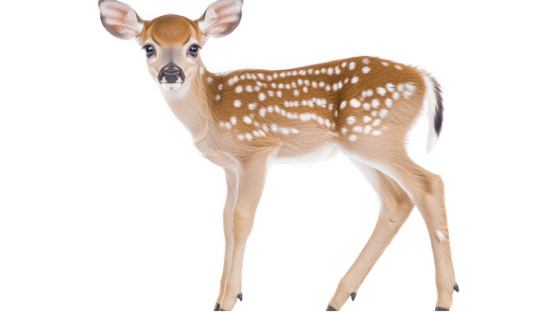




WHO IS CUTER?
4 New Titles
• ATOS: N/A
• Lexile: TBD
• Colorful, labeled
photos highlight
animals’ similarities &
differences
READING LEVEL: Gr. 1
INTEREST LEVEL: Gr. K-3
Notes:
SERIES COVERS - BELLWETHER

Slide 10
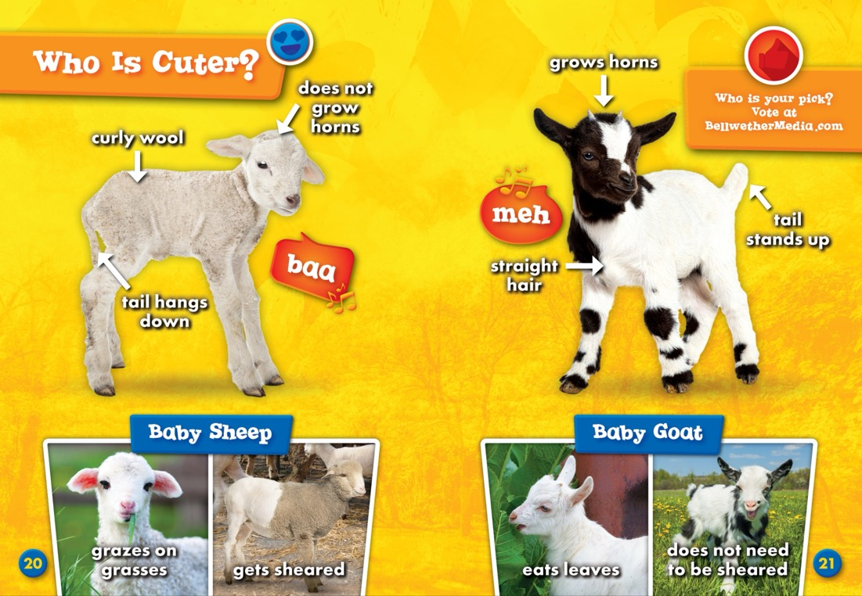

Notes:
SERIES SPREAD 1 - BELLWETHER

Slide 11





FIRST WORDS IN…
4 New Titles
• ATOS: N/A
• Lexile: TBD
• Introduction to key phrases including
greetings, family words, and school words
• Word Pronunciations
READING LEVEL: Gr. 1
INTEREST LEVEL: Gr. K-3
Notes:
SERIES COVERS - BELLWETHER

Slide 12


Notes:
SERIES SPREAD 1 - BELLWETHER

Slide 13










Countries of
the World
8 New Titles
• ATOS: N/A
• Lexile: TBD
• Maps & Geographical
Profiles
• Facts about
country’s natural
features, animals,
food, and
celebrations
READING LEVEL: Gr. 1-2
INTEREST LEVEL: Gr. K-3
Notes:
SERIES COVERS - BELLWETHER

Slide 14
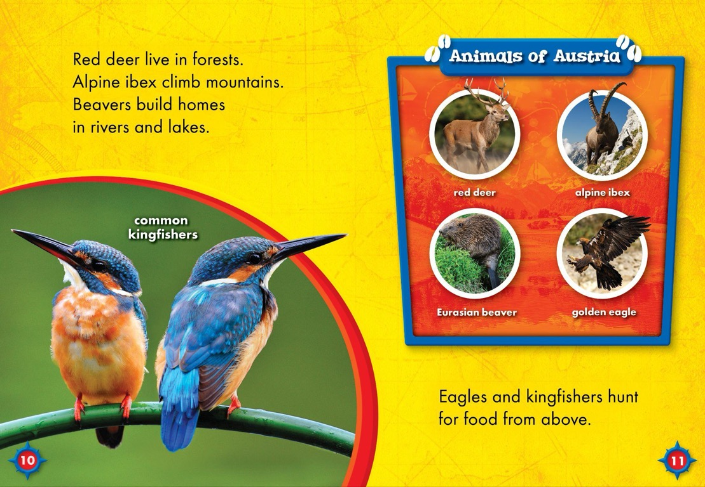

Notes:
SERIES SPREAD 1 - BELLWETHER

Slide 15












THE ULTIMATE ANIMAL LIBRARY
10 New Titles
• ATOS: N/A
• Lexile: TBD
• Features:
Highlights
animals’ life stages,
food webs, habitats,
and more!
READING LEVEL: Gr. 1-2
INTEREST LEVEL: Gr. K-3
Notes:
SERIES COVERS - BELLWETHER

Slide 16
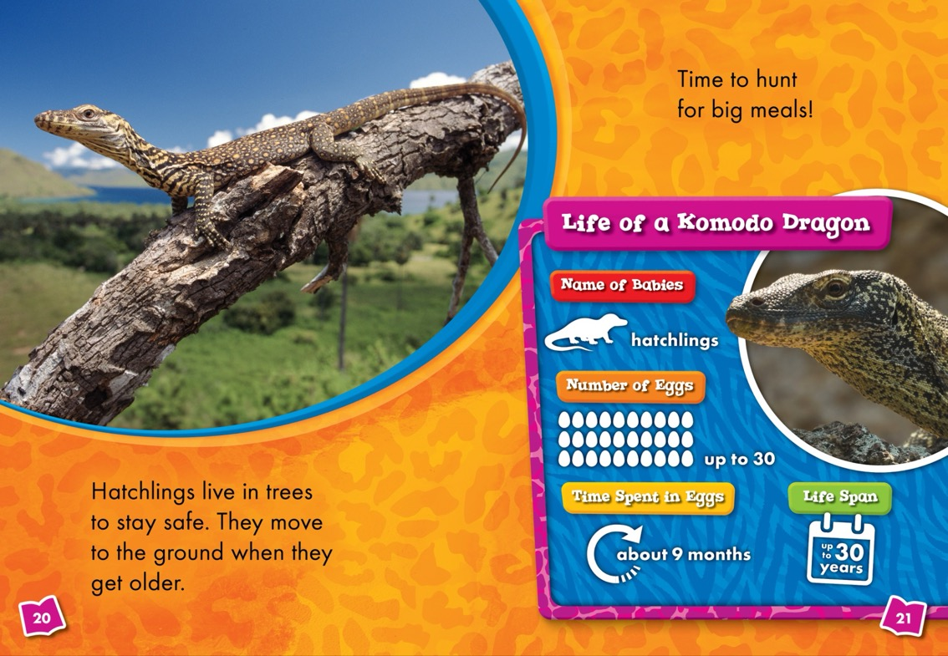

Notes:
SERIES SPREAD 1 - BELLWETHER

Slide 17








SHIPS AHOY!
6 New Titles
• ATOS: TBD
• Lexile: TBD
• Features show off parts of ships
READING LEVEL: Gr. 1-2
INTEREST LEVEL: Gr. K-3
Notes:
SERIES COVERS - BELLWETHER

Slide 18
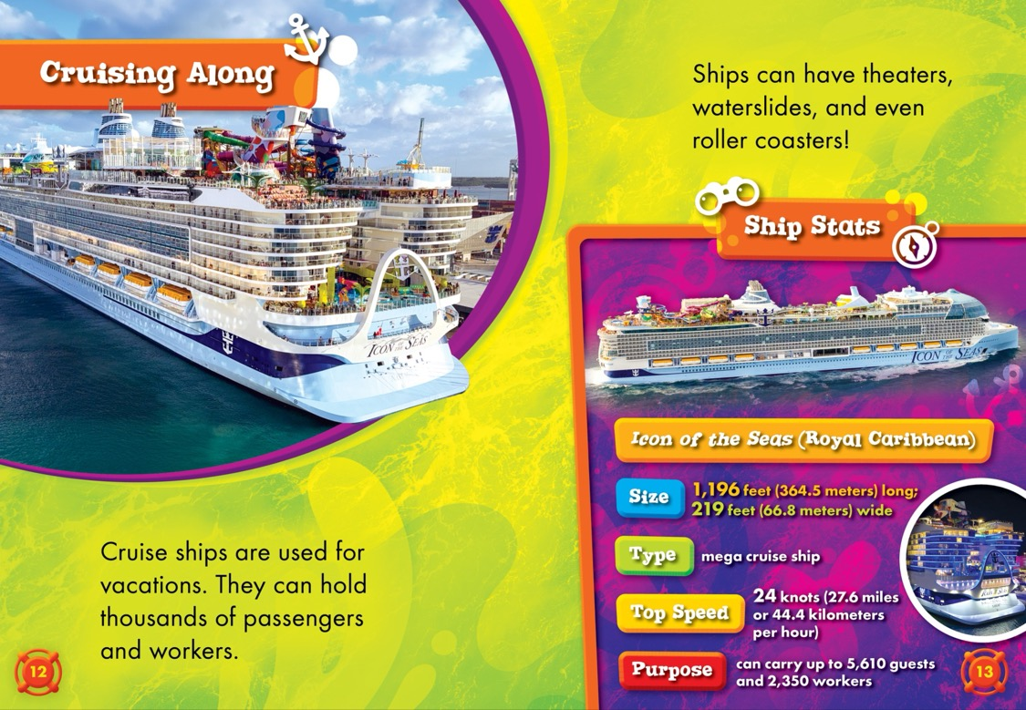

Notes:
SERIES SPREAD 1 - BELLWETHER

Slide 19








WORLD FAMOUS BUILDINGS
5 New Titles
• ATOS: TBD
• Lexile: TBD
• Features include maps,
size comparison charts,
and building supply lists
• Profiles of buildings’
unique parts
READING LEVEL: Gr. 2-3
INTEREST LEVEL: Gr. K-3
Notes:
SERIES COVERS - BELLWETHER

Slide 20


Notes:
SERIES SPREAD 1 - BELLWETHER

Slide 21








U.S. GOVERNMENT BUILDINGS
6 New Titles
• ATOS: TBD
• Lexile: TBD
• Perfect for observing America’s
Semiquincentennial
(250th anniversary)
• Text highlights buildings’
history and creation
READING LEVEL: Gr. 2-3
INTEREST LEVEL: Gr. K-3
Notes:
SERIES COVERS - BELLWETHER

Slide 22
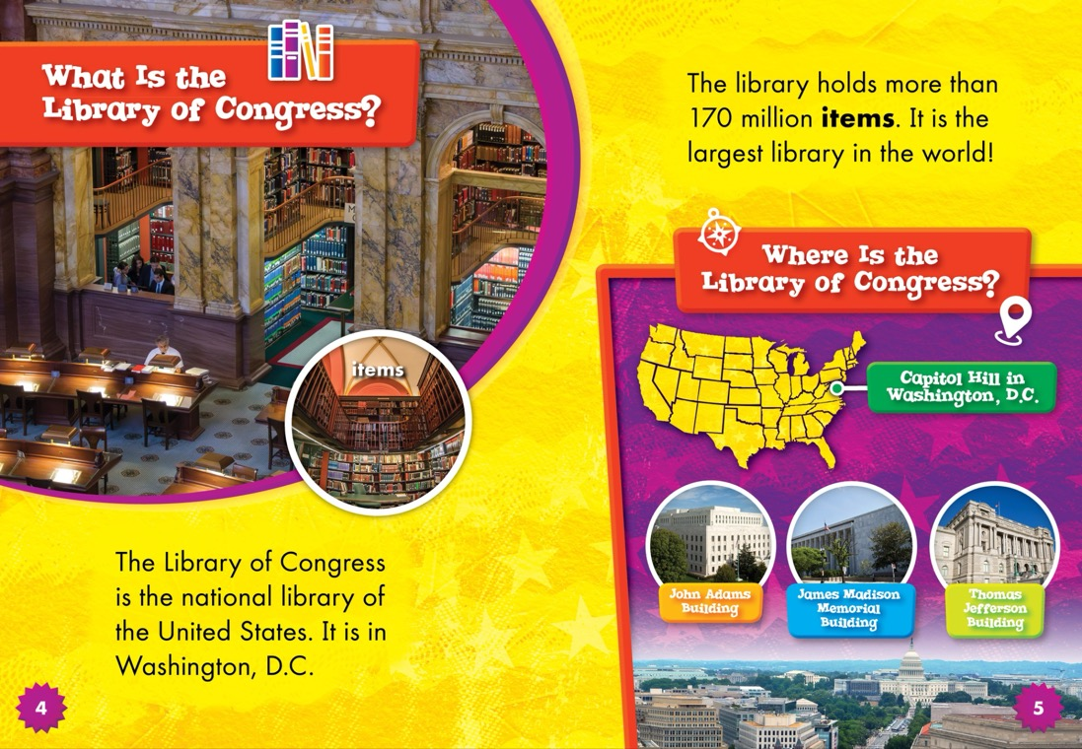

Notes:
SERIES SPREAD 1 - BELLWETHER

Slide 23

ILLUSTRATED NARRATIVE NONFICTION
Reading Level: Grades 1-2
Interest Level: Grades K-3
ATOS Range: 2.0-2.5
Lexile Range: 430-530
Pages: 24
Hardcover: $20.97
Ebook: $19.99
Paperback: $7.99
Notes:
IMPRINT INTRO - BELLWETHER

Slide 24



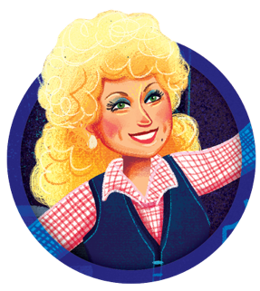


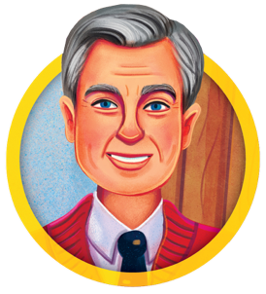


LEGENDARY LIVES
4 New Titles
• ATOS: TBD
• Lexile: TBD
• Illustrated biographies
• Profiles, timelines, and
discussion questions
READING LEVEL: Gr. 1-2
INTEREST LEVEL: Gr. K-3
Notes:
SERIES COVERS - BELLWETHER

Slide 25
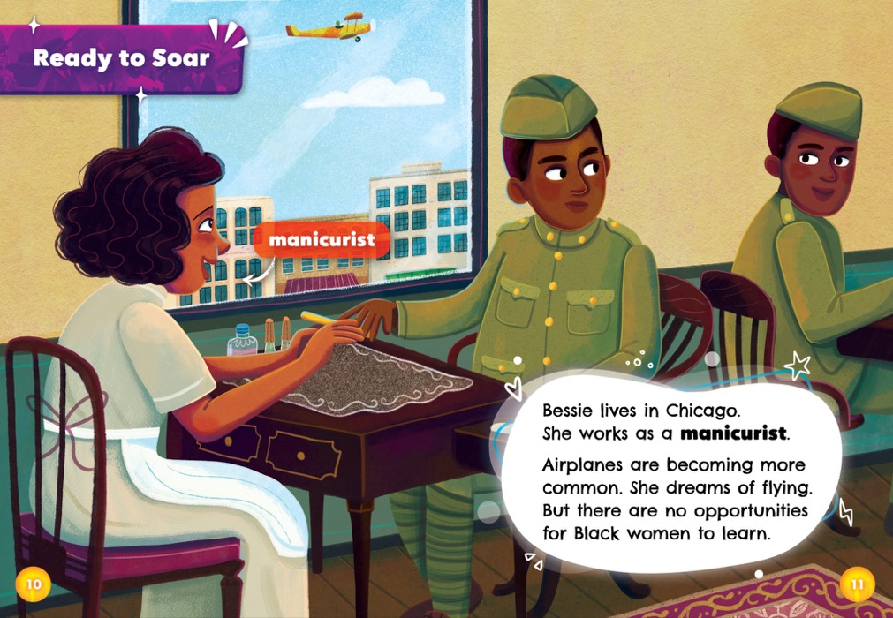

Notes:
SERIES SPREAD 1 - BELLWETHER

Slide 26


LEARN, EXPLORE, DISCOVER
Reading Level: Grade 4
Interest Level: Grades 3-8
ATOS Range: 3.5-5.5
Lexile Range:
Pages: 32
Hardcover: $26.67
Ebook: $19.99
Paperback: $8.99
Notes:
IMPRINT INTRO - BELLWETHER

Slide 27







U.S.
NATIONAL
PARKS
4 New Titles
• ATOS: TBD
• Lexile: TBD
• Animal profiles, diagrams, and maps
• List of stats, animal food webs, and timelines
READING LEVEL: Gr. 4
INTEREST LEVEL: Gr. 3-8
Notes:
SERIES COVERS - BELLWETHER

Slide 28
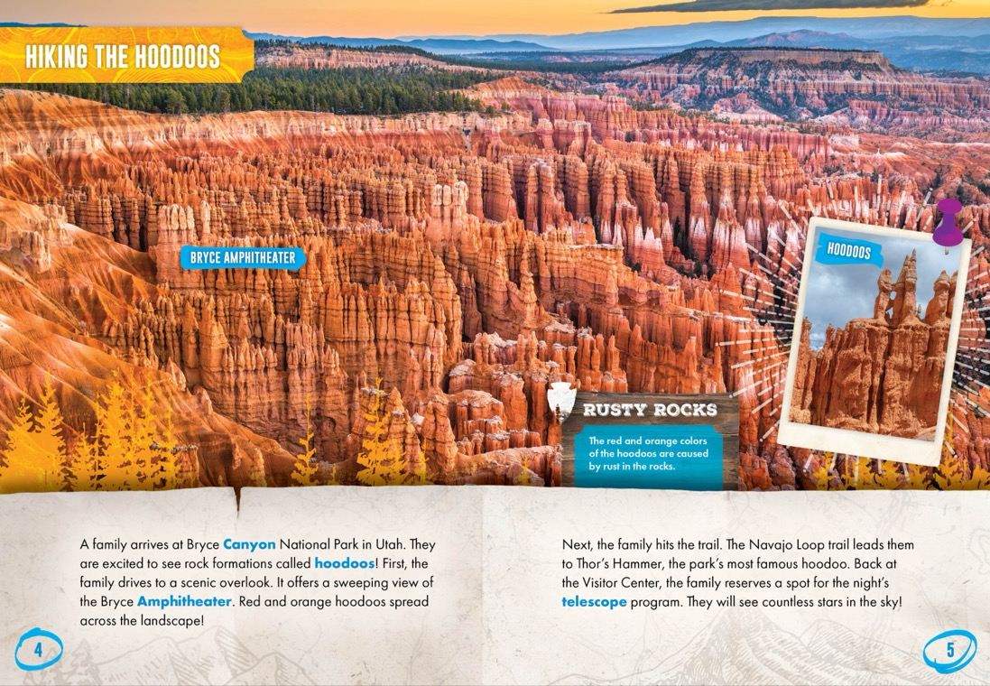

Notes:
SERIES SPREAD 1 - BELLWETHER

Slide 29





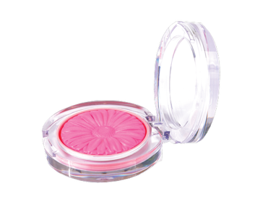


BEHIND THE BRAND
4 New Titles
• ATOS: TBD
• Lexile: TBD
• Profiles on brands’ key
contributors
• Sales states & charitable
contributions
READING LEVEL: Gr. 4
INTEREST LEVEL: Gr. 3-8
Notes:
SERIES COVERS - BELLWETHER

Slide 30
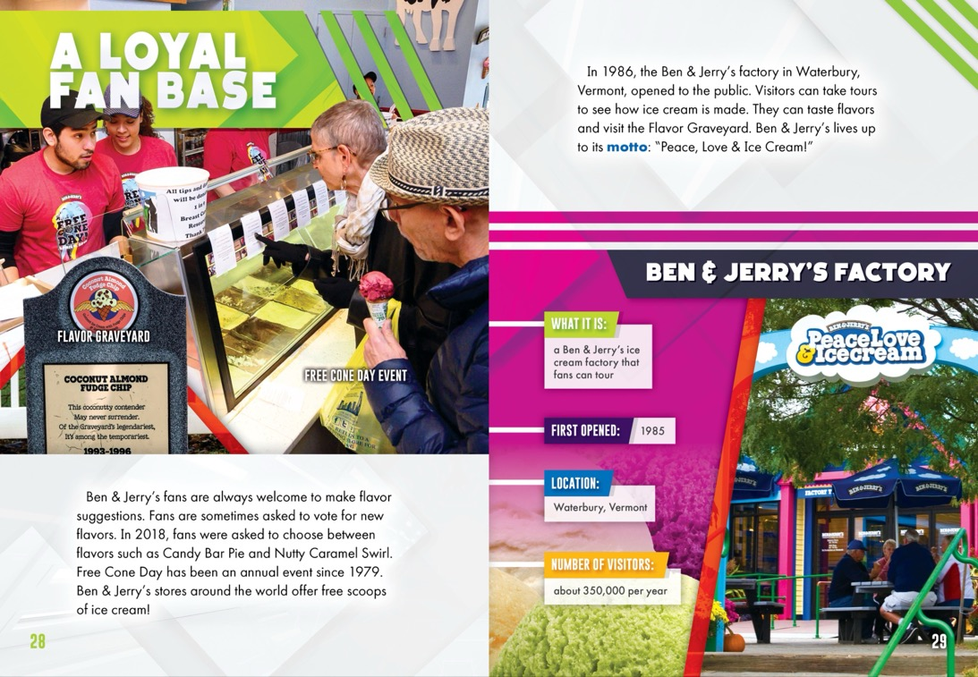

Notes:
SERIES SPREAD 1 - BELLWETHER

Slide 31


HI ULTRA-LO
Reading Level: Grade 2
Interest Level: Grades 3-7
ATOS Range: 2.5-3.5
Lexile Range: 740-770
Pages: 24
Hardcover: $20.97
Ebook: $19.99
Paperback: $9.99
Notes:
IMPRINT INTRO - BELLWETHER

Slide 32







ICE AGE ANIMALS
4 New Titles
• ATOS: N/A
• Lexile: TBD
• Text explores each animal’s
interactions with early humans
• Size comparisons to common objects
• Back matter includes spread that
summarizes information
READING LEVEL: Gr. 2
INTEREST LEVEL: Gr. 3-7
Notes:
SERIES COVERS - BELLWETHER

Slide 33
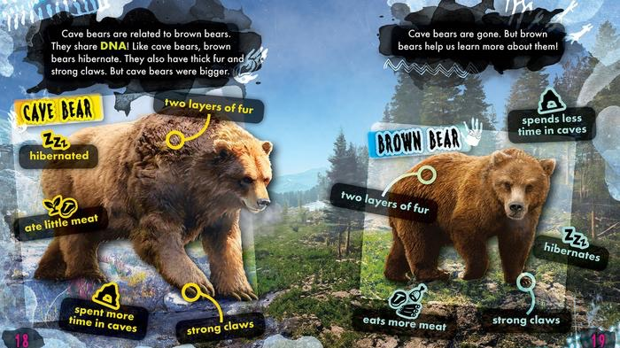
Notes:
SERIES SPREAD 1 - BELLWETHER

Slide 34





OUR FAVORITE
VIDEO GAMES
4 New Titles
• ATOS: N/A
• Lexile: TBD
• Timelines, profiles, and graphs
• Features help readers stay
engaged and retain information
READING LEVEL: Gr. 2
INTEREST LEVEL: Gr. 3-7
Notes:
SERIES COVERS - BELLWETHER

Slide 35
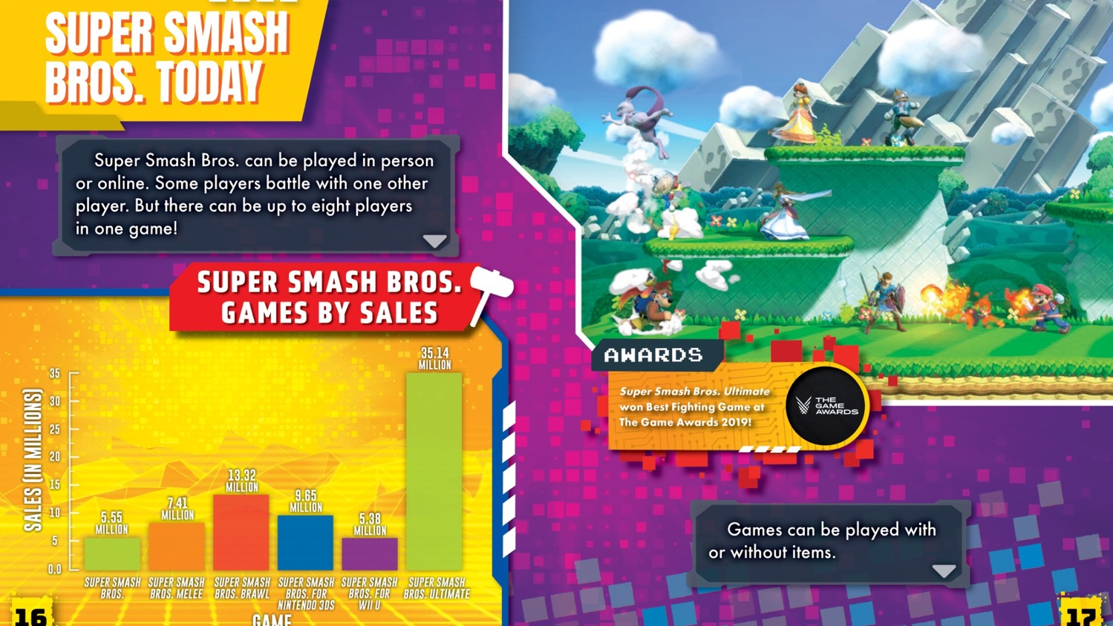
Notes:
SERIES SPREAD 1 - BELLWETHER

Slide 36








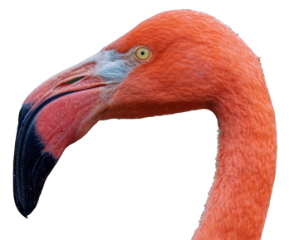
ANIMAL SUPERPOWERS
4 New Titles
• ATOS: TBD
• Lexile: TBD
• Maps, fun facts, and diagrams
READING LEVEL: Gr. 2
INTEREST LEVEL: Gr. 3-7
Notes:
SERIES COVERS - BELLWETHER

Slide 37
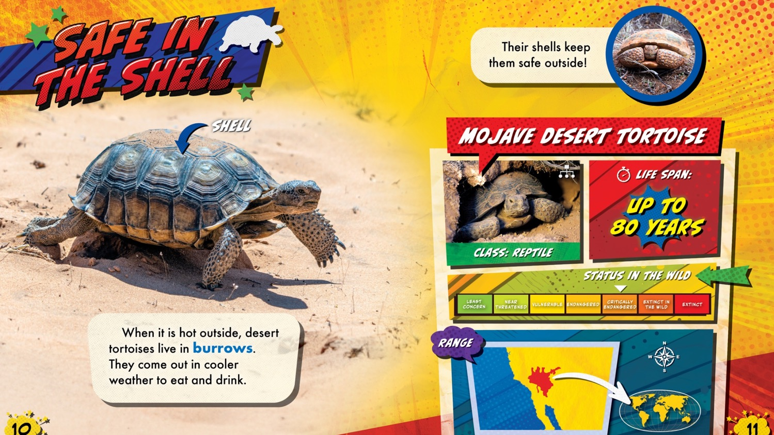
Notes:
SERIES SPREAD 1 - BELLWETHER

Slide 38


HI-LO
Reading Level: Grade 3
Interest Level: Grades 3-7
ATOS Range: 3.0-5.0
Lexile Range: 550-760
Pages: 24
Hardcover: $20.97
Ebook: $19.99
Notes:
IMPRINT INTRO - BELLWETHER

Slide 39



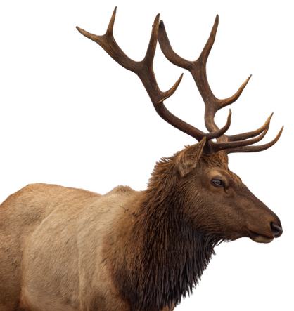


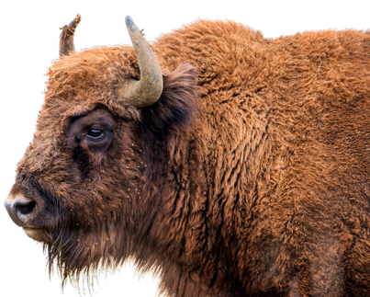

ANIMAL BATTLES
4 New Titles
• ATOS: TBD
• Lexile: TBD
• Comparisons of animals’ weapons and strategies
• Action-packed narrative fight scene
READING LEVEL: Gr. 3
INTEREST LEVEL: Gr. 3-7
Notes:
SERIES COVERS - BELLWETHER

Slide 40
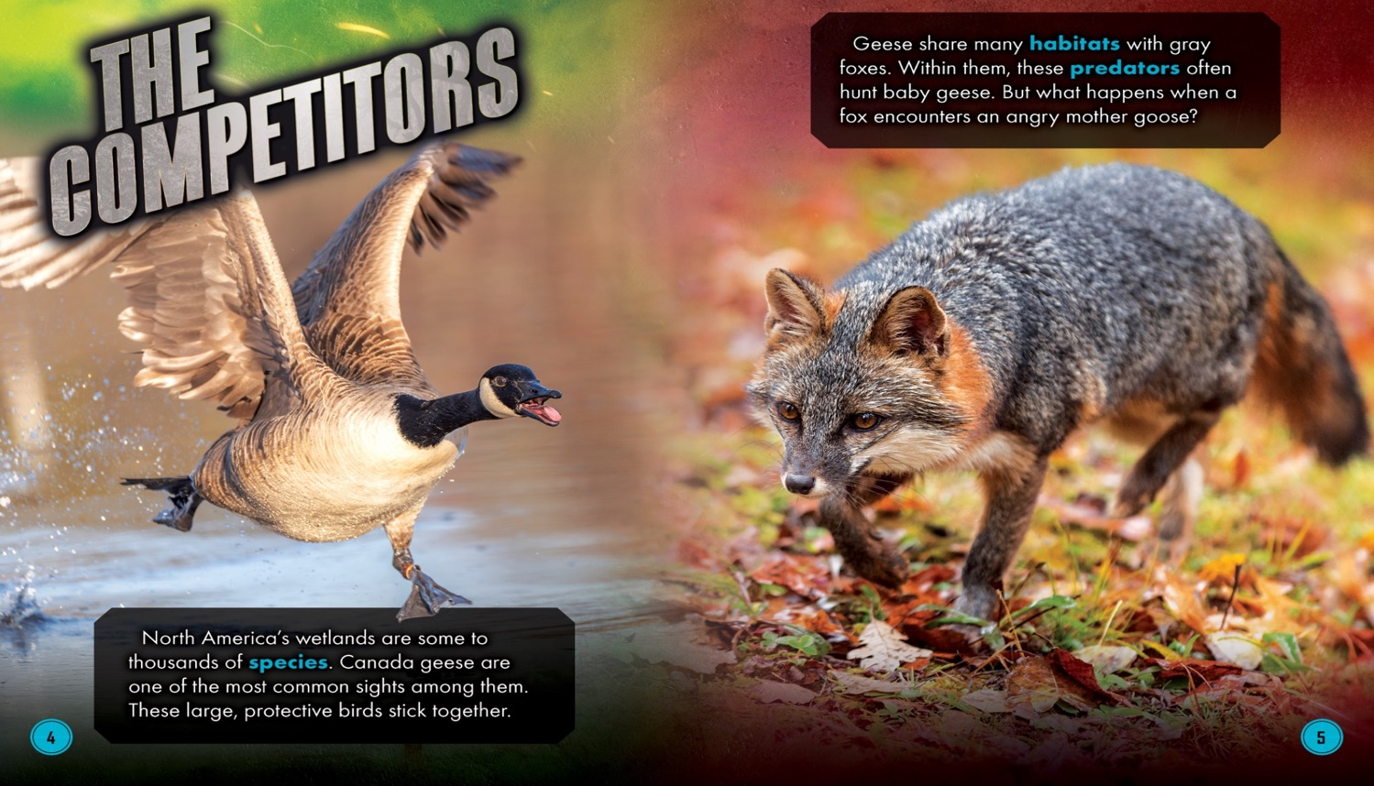
Notes:
SERIES SPREAD 1 - BELLWETHER

Slide 41





MUSIC SUPERSTARS
4 New Titles
• ATOS: TBD
• Lexile: TBD
• Profiles highlight artists’
favorite colors, foods, and more
• Lists of each artists’
best-known songs and awards
• Facts & positive narratives–
no gossip!
READING LEVEL: Gr. 3
INTEREST LEVEL: Gr. 3-7
Notes:
SERIES COVERS - BELLWETHER

Slide 42

Notes:
SERIES SPREAD 1 - BELLWETHER

Slide 43







SPORTS SUPERSTARS
6 New Titles
• ATOS: TBD
• Lexile: TBD
• Text covers athletes’ carers
from childhood to championships
• Maps, trophy shelves, and athlete favorites
READING LEVEL: Gr. 3
INTEREST LEVEL: Gr. 3-7
Notes:
SERIES COVERS - BELLWETHER

Slide 44
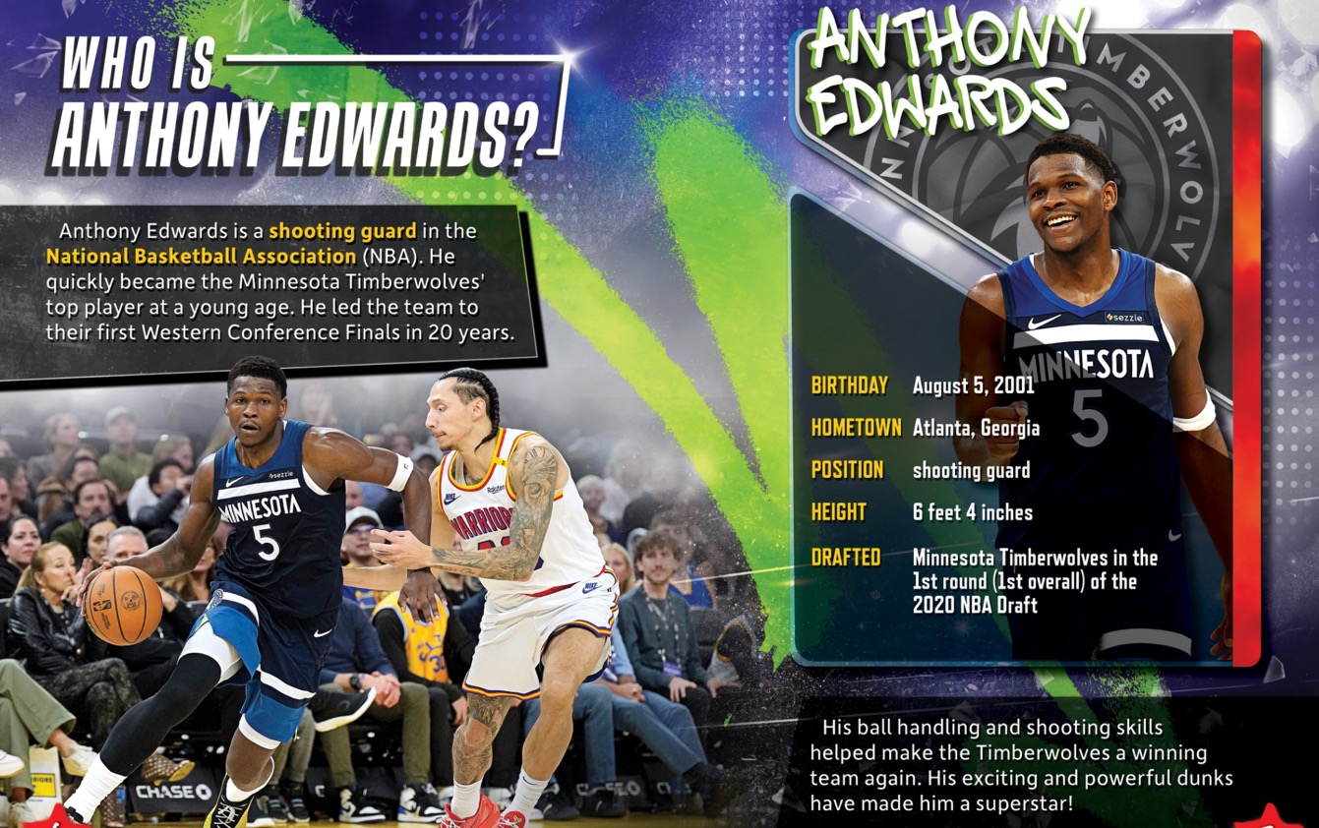
Notes:
SERIES SPREAD 1 - BELLWETHER

Slide 45


HIGH-INTEREST MIDDLE SCHOOL
Reading Level: Grades 3-4
Interest Level: Grades 5-8
ATOS Range: 5.0-6.5
Lexile Range: 780-1010
Pages: 48
Hardcover: $22.37
Ebook: $19.99
Notes:
IMPRINT INTRO - BELLWETHER

Slide 46







ANIMAL ALBUMS
6 New Titles
• ATOS: N/A
• Lexile: TBD
• Taxonomy charts
• Evolutionary adaptations
• Size comparison feature
READING LEVEL: Gr. 3-4
INTEREST LEVEL: Gr. 5-8
Notes:
SERIES COVERS - BELLWETHER

Slide 47
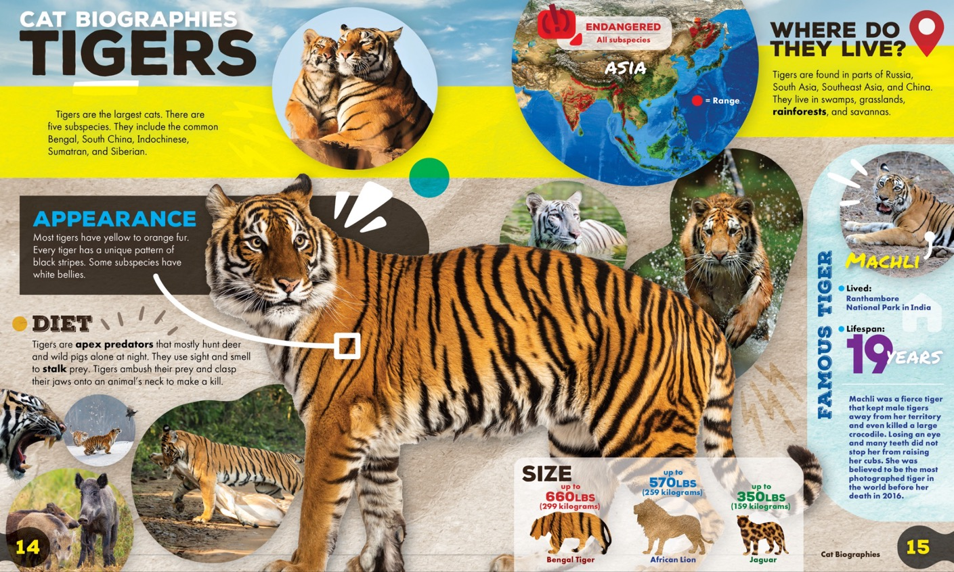
Notes:
SERIES SPREAD 1 - BELLWETHER

Slide 48



SPRING 2026
Presented by the editorial staff

Slide 49


EARLY READERS AND BEGINNING CONCEPTS
Reading Levels: Grade 1
Interest Level: Grades K-1
ATOS Range: 0.5-2.5
Lexile Range: 400-470
Pages: 24
Hardcover: $20.97
Ebook: $19.99
Paperback: $7.99

Slide 50







U.S. SYMBOLS
New Series!
• ATOS: N/A
• Lexile: TBD
• Perfect for observing America’s
Semiquincentennial (250th anniversary)
• Kid-friendly explanations for relevance
of symbols today
READING LEVEL: Gr. 1
INTEREST LEVEL: Gr. K-1

Slide 51
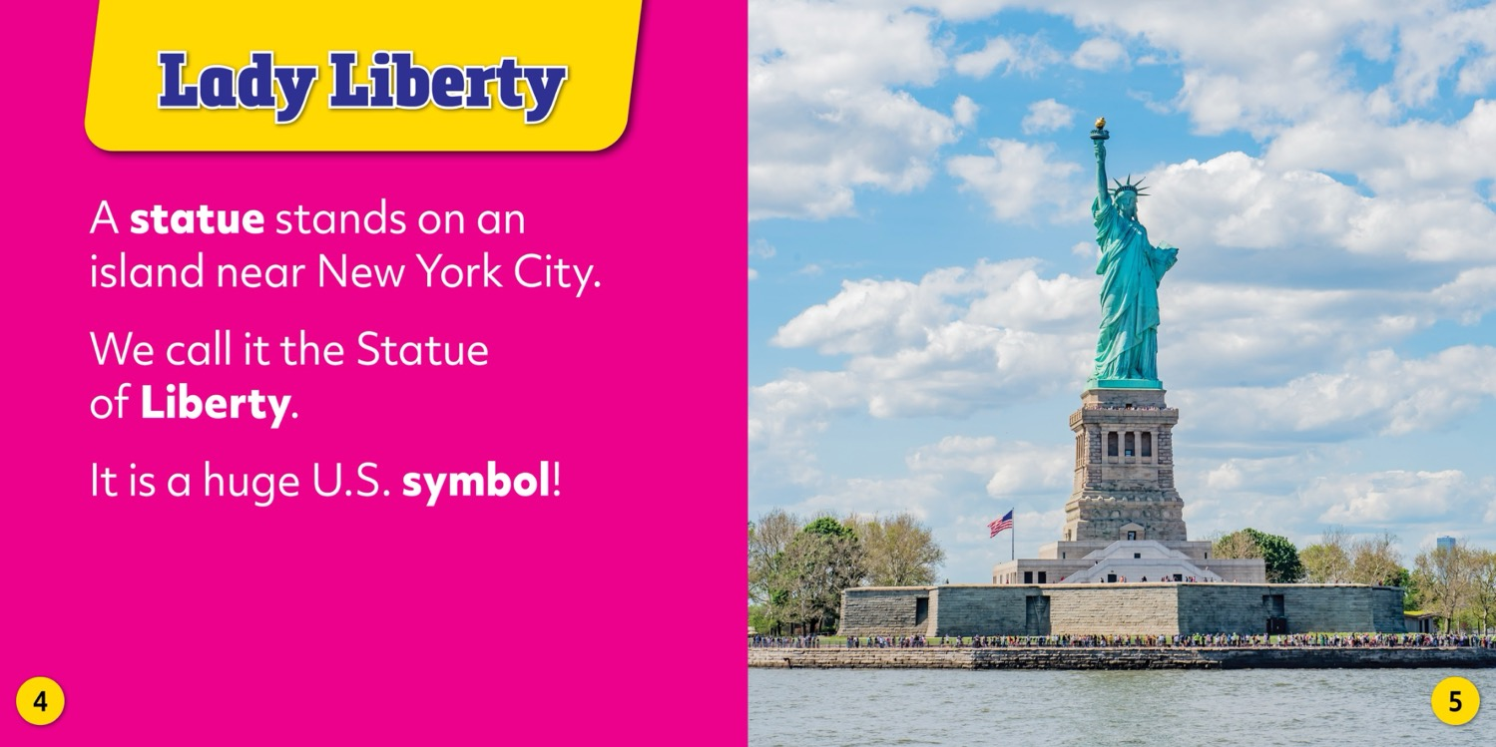

Slide 52
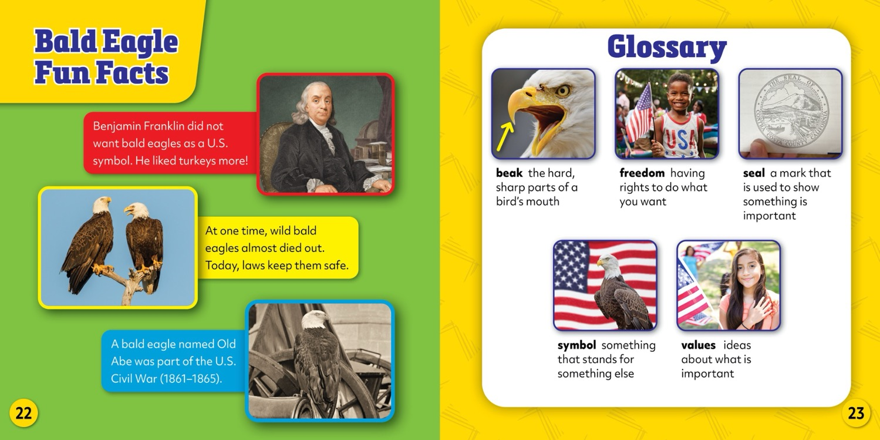

Slide 53





A BETTER YOU
New Series!
• ATOS: N/A
• Lexile: TBD
• Early life skills
• Practical guidance for
everyday situations
• Back matter features role
models who exemplify personal growth
READING LEVEL: Gr. 1
INTEREST LEVEL: Gr. K-1

Slide 54
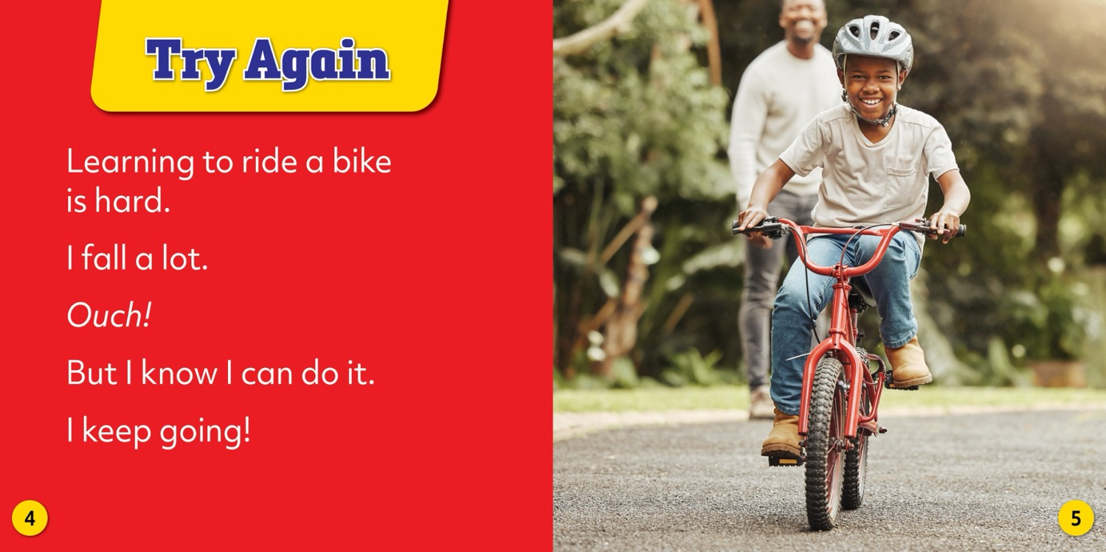

Slide 55
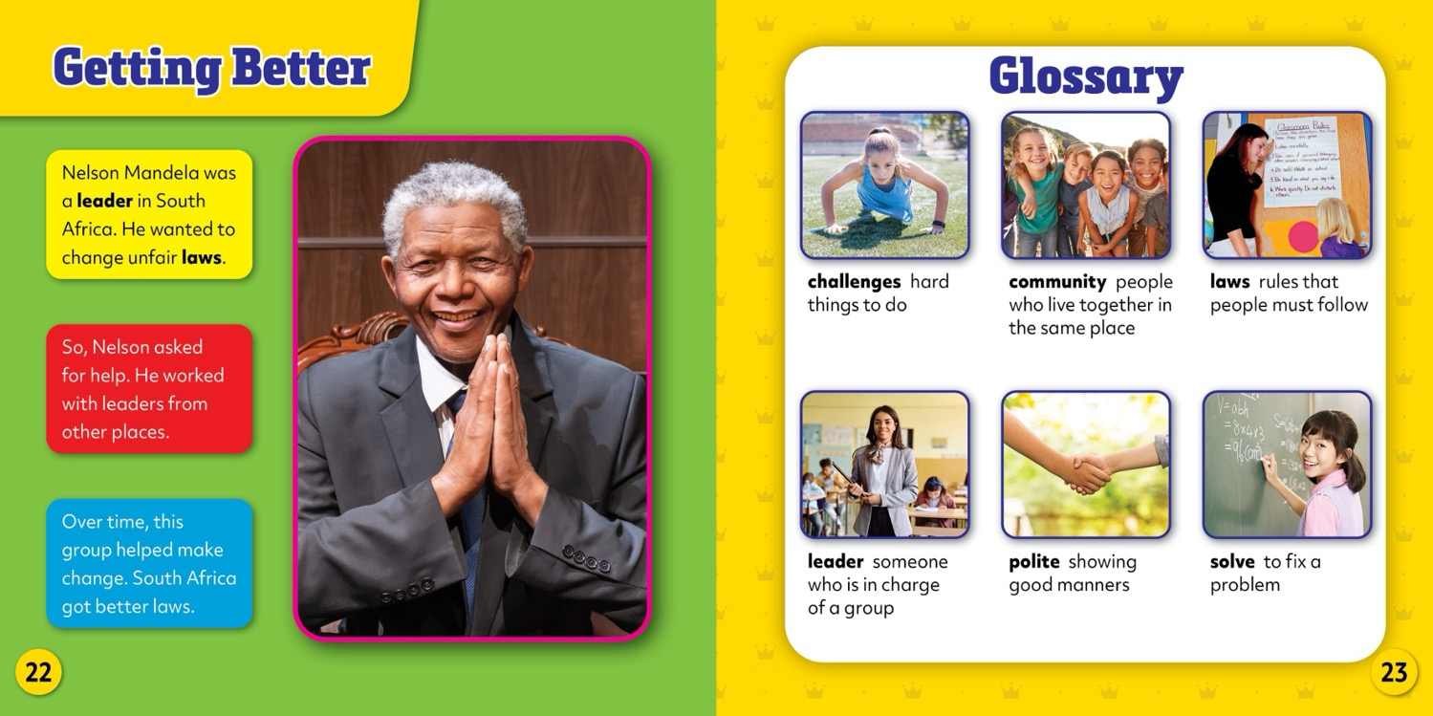

Slide 56







TECH TALK
New Series!
• ATOS: N/A
• Lexile: TBD
• Exploration of how
everyday tech works
• Back matter shows how
technology has changed
over time
READING LEVEL: Gr. 1
INTEREST LEVEL: Gr. K-1

Slide 57
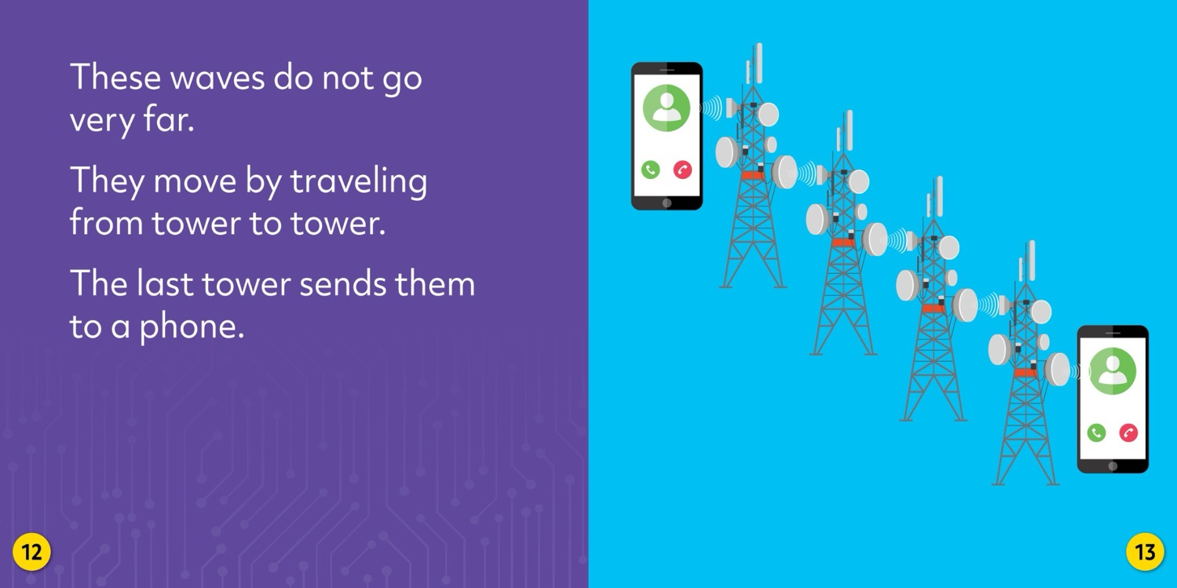

Slide 58
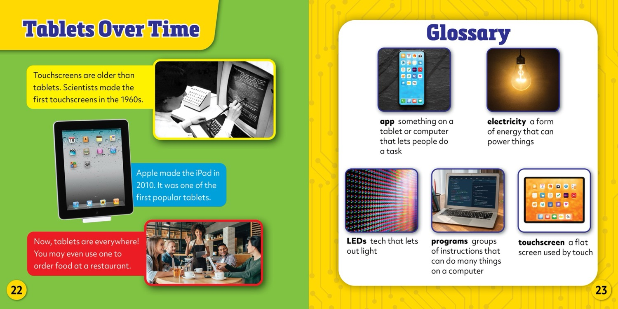

Slide 59







WHERE DID IT COME FROM?
New Series!
• ATOS: TBD
• Lexile: TBD
• Text explores the who,
how, and why of
each object
• Narrative explanations
foster curiosity
READING LEVEL: Gr. 1
INTEREST LEVEL: Gr. K-1

Slide 60
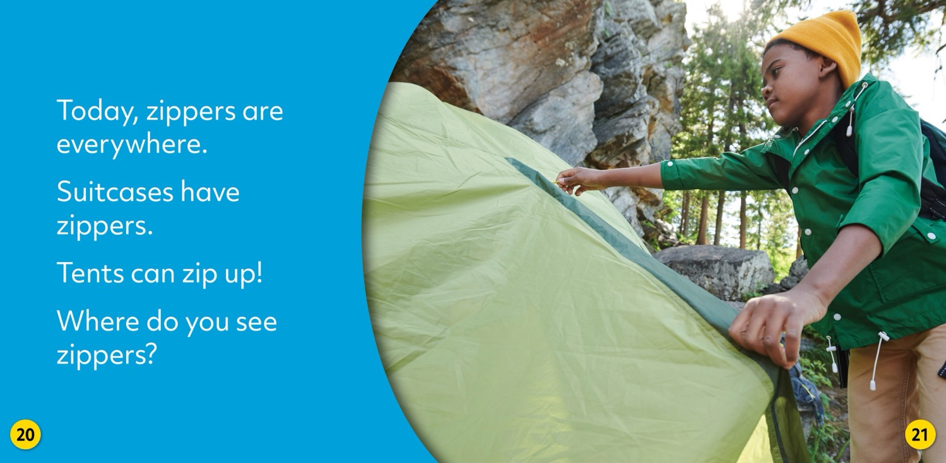

Slide 61
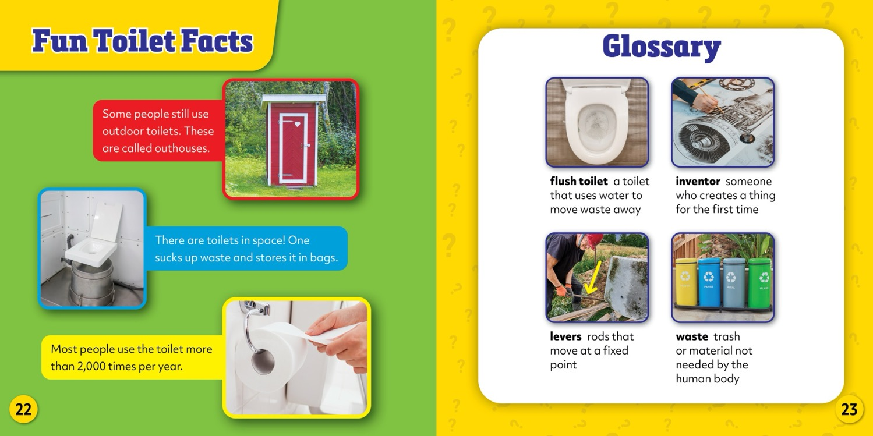

Slide 62









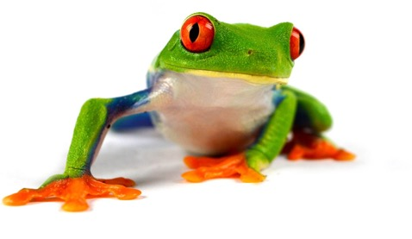
LIFE EVERYWHERE
New Series!
• ATOS: TBD
• Lexile: TBD
• Zoomed-in biome feature
includes fun facts
• Aligns with NGSS Life
Science Standards on
biomes and ecosystems
READING LEVEL: Gr. 1
INTEREST LEVEL: Gr. K-1

Slide 63
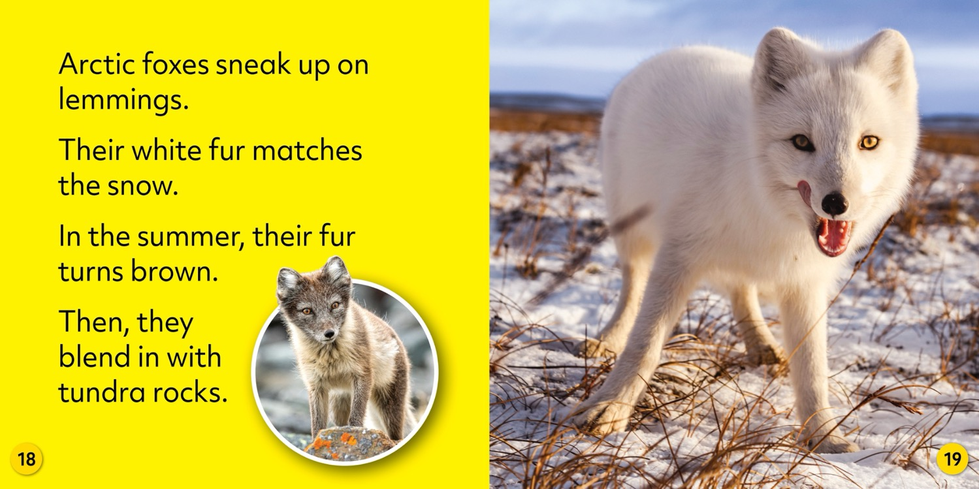

Slide 64
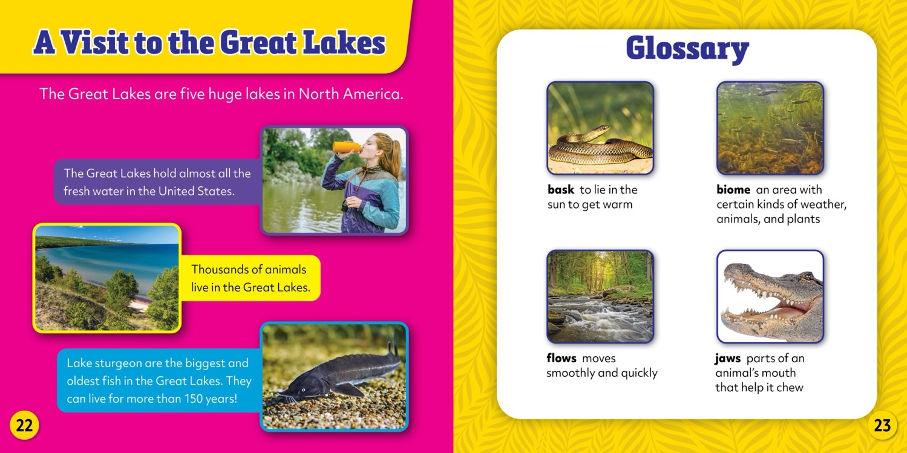

Slide 65


FUN, FACTUAL, ENGAGING
Reading Levels: Grades 2-3
Interest Level: Grades 1-3
ATOS Range: 3.0-4.0
Lexile Range: 560-790
Pages: 24
Hardcover: $21.67
Ebook: $19.99
Paperback: $7.99

Slide 66









AMERICAN TOUR
New Series!
• ATOS: TBD
• Lexile: TBD
• Perfect for observing
America’s Semiquincentennial
(250th anniversary)
• Avery the Eagle guides readers
through iconic American
landmarks
READING LEVEL: Gr. 2-3
INTEREST LEVEL: Gr. 1-3
Notes:
SERIES COVERS - BELLWETHER

Slide 67
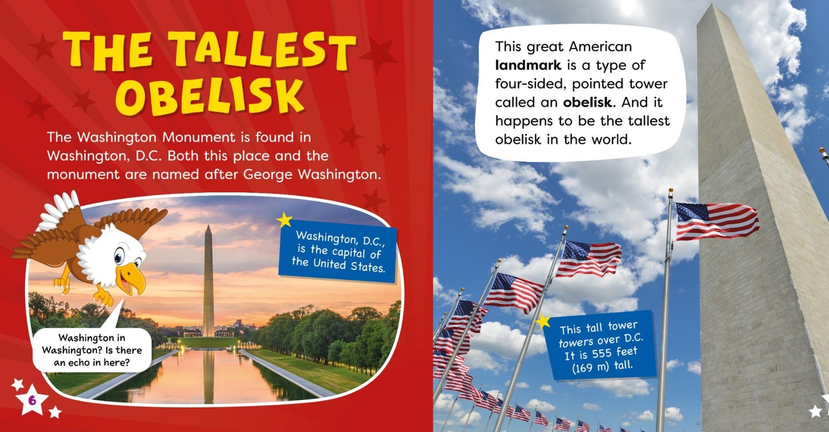
Notes:
SERIES SPREAD 2 - BEARPORT

Slide 68
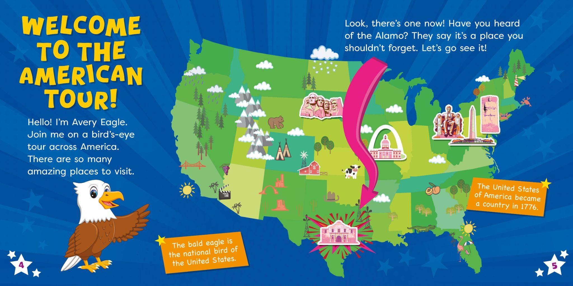
Notes:
SERIES SPREAD 1 - BEARPORT

Slide 69
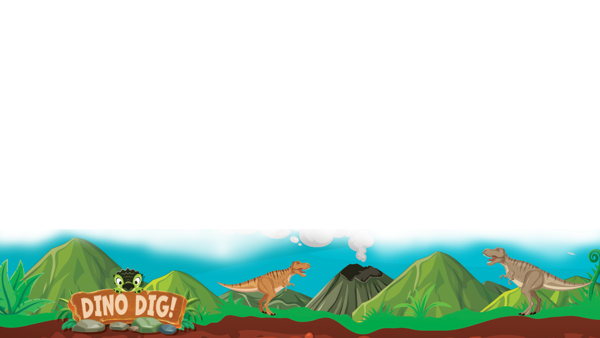
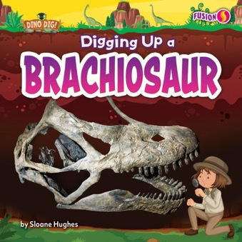








DINO DIG!
New Series!
• ATOS: TBD
• Lexile: TBD
• Paleontologist narrators
introduce readers to
their fascinating job
• Fun fossil facts
READING LEVEL: Gr. 2-3
INTEREST LEVEL: Gr. 1-3
Notes:
SERIES COVERS - BELLWETHER

Slide 70
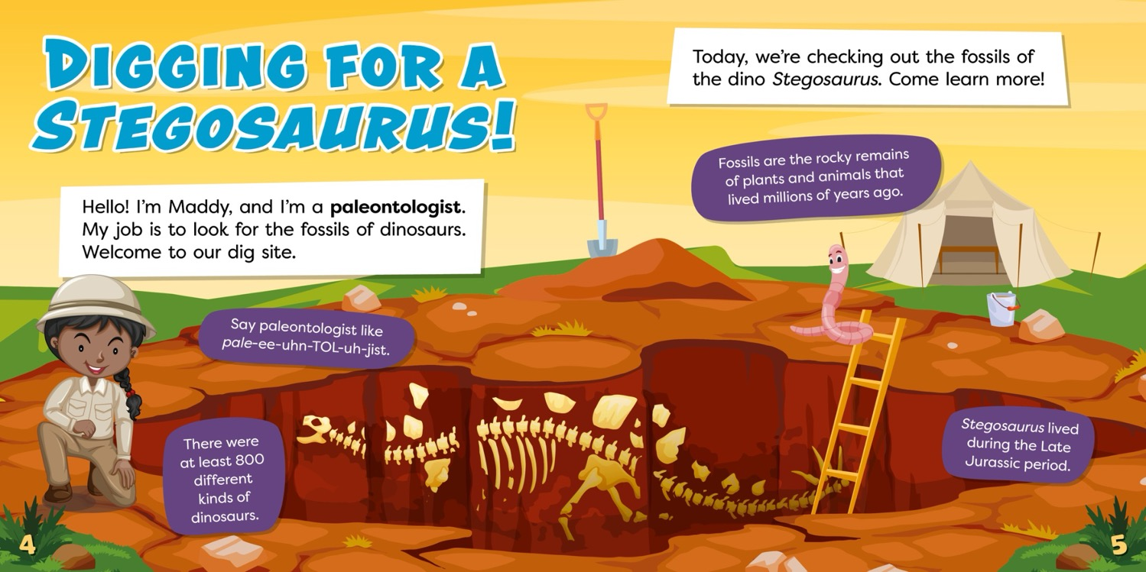
Notes:
SERIES SPREAD 1 - BEARPORT

Slide 71
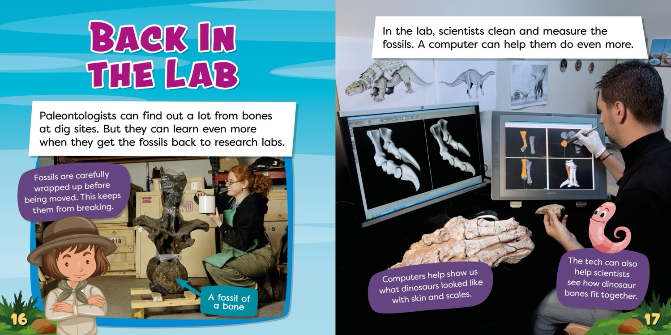
Notes:
SERIES SPREAD 2 - BEARPORT

Slide 72







BEYOND THE CLASSROOM
New Series!
• ATOS: N/A
• Lexile: TBD
• Examples and questions
encourage real-life applications
of history, literacy, math, and science
READING LEVEL: Gr. 2-3
INTEREST LEVEL: Gr. 1-3
Notes:
SERIES COVERS - BELLWETHER

Slide 73
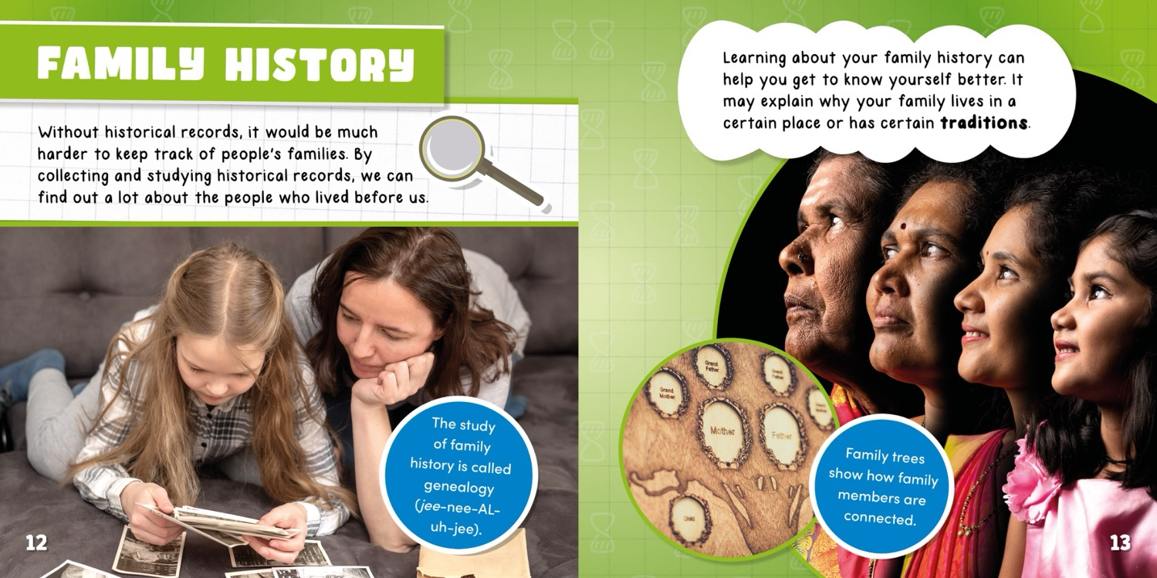
Notes:
SERIES SPREAD 1 - BEARPORT

Slide 74

Notes:
SERIES SPREAD 2 - BEARPORT

Slide 75








SEE-GULLS OCEAN TOURS SET TWO
READING LEVEL: Gr. 2-3
INTEREST LEVEL: Gr. 1-3
6
New Titles
• ATOS: TBD
• Lexile: TBD
• Animal narrators lead
readers on an ocean tour
• Exploration of animals’
appearance, survival
skills, and habitats
Notes:
SERIES COVERS - BELLWETHER

Slide 76
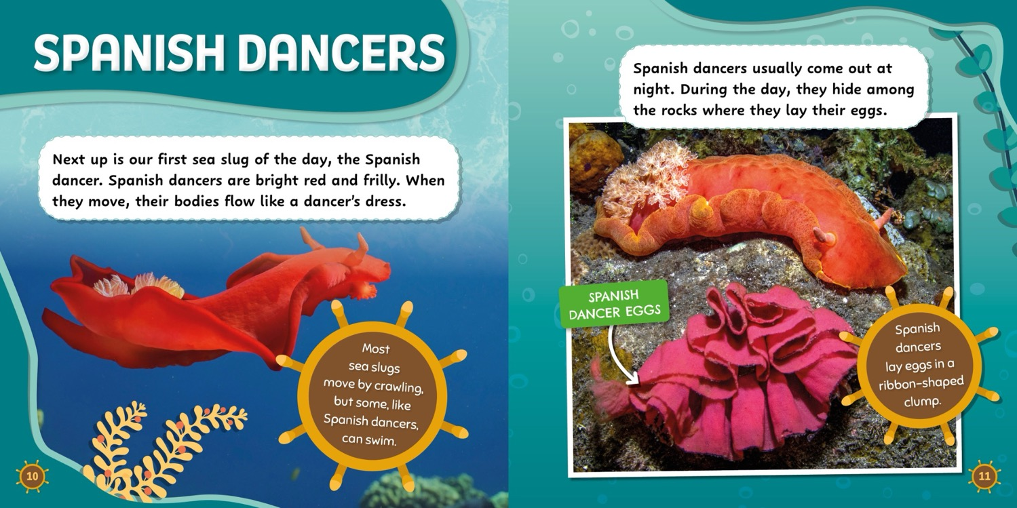
Notes:
SERIES SPREAD 1 - BEATPORT

Slide 77
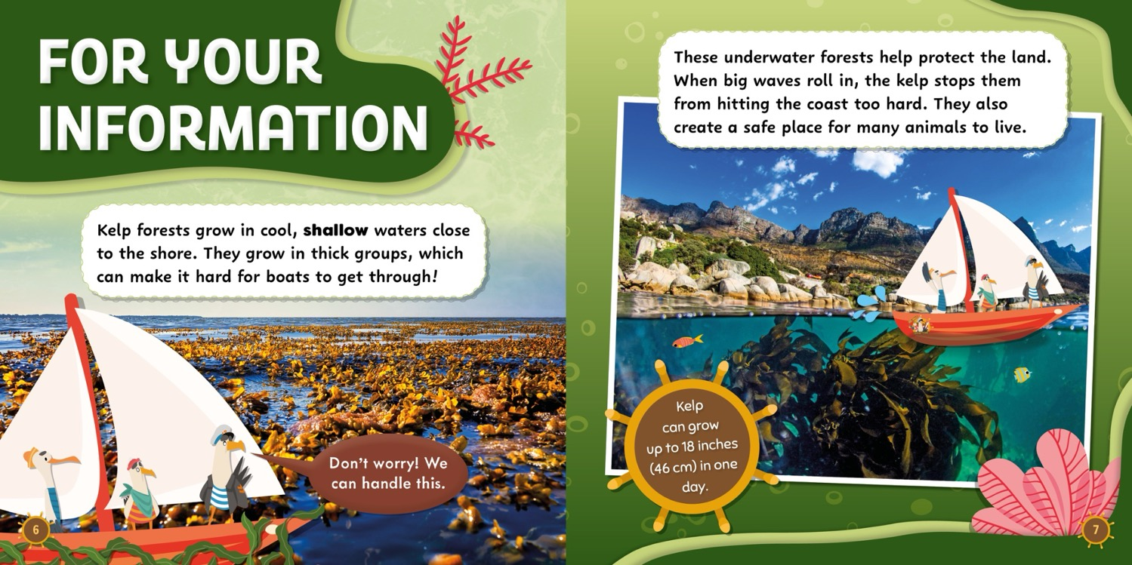
Notes:
SERIES SPREAD 2 - BEARPORT

Slide 78


BEARPORT BOOKS
WHERE CURIOSITY MEETS CONFIDENCE
Reading Levels: Grade 3
Interest Level: Grades 2-5
ATOS Range: 4.0-4.9
Lexile Range: 590-1010
Pages: 24
Hardcover: $21.67
Ebook: $19.99
Paperback: $7.99
Notes:
IMPRINT INTRO - BELLWETHER

Slide 79




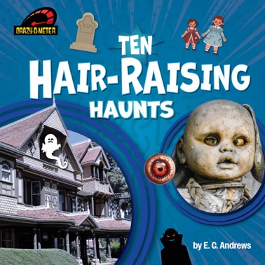



CRAZY-O-METER
New Series!
• ATOS: N/A
• Lexile: TBD
• Features unusual and extreme content
• Fun list format engages readers and
builds recall
READING LEVEL: Gr. 3
INTEREST LEVEL: Gr. 2-4
Notes:
SERIES COVERS - BELLWETHER

Slide 80

Notes:
SERIES SPREAD 1 - BEARPORT

Slide 81
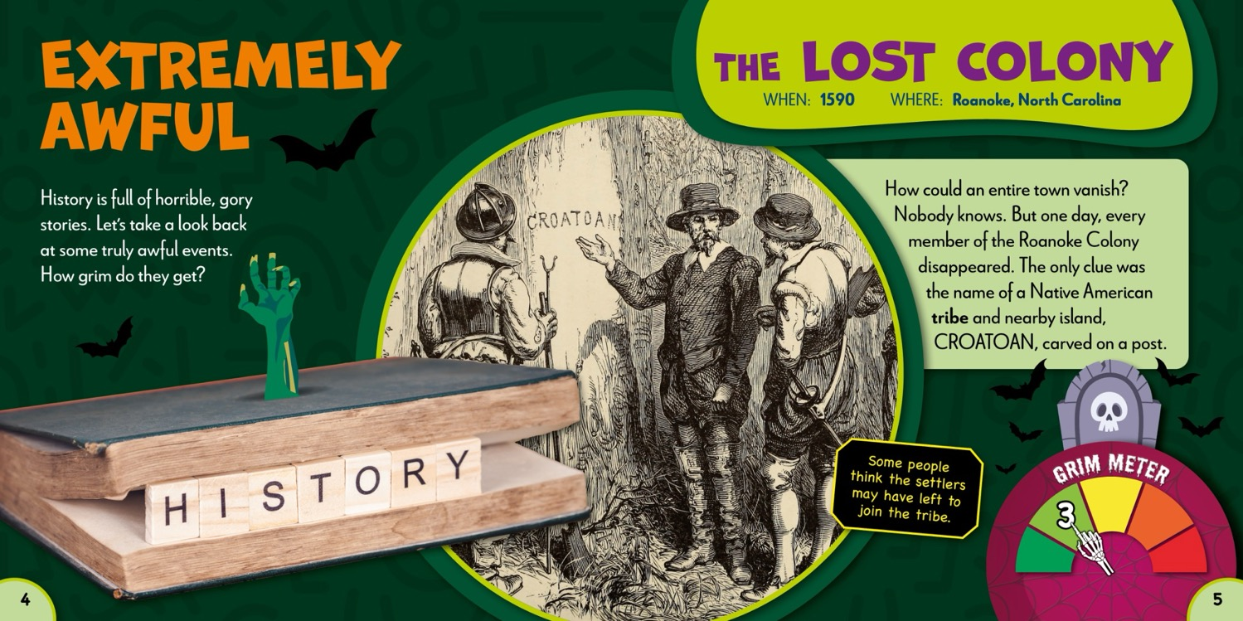
Notes:
SERIES SPREAD 2 - BEARPORT

Slide 82
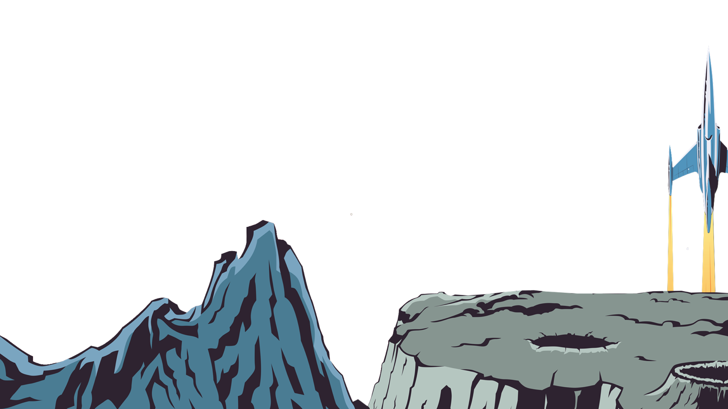
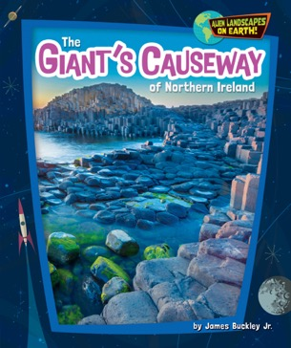


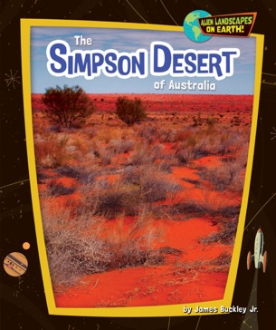



ALIEN
LANDSCAPES ON EARTH!
New Series!
• ATOS: TBD
• Lexile: TBD
• Stunning visuals capture
unique landscapes
• Links Earth geography to
space science
READING LEVEL: Gr. 3
INTEREST LEVEL: Gr. 2-4
Notes:
SERIES COVERS - BELLWETHER

Slide 83
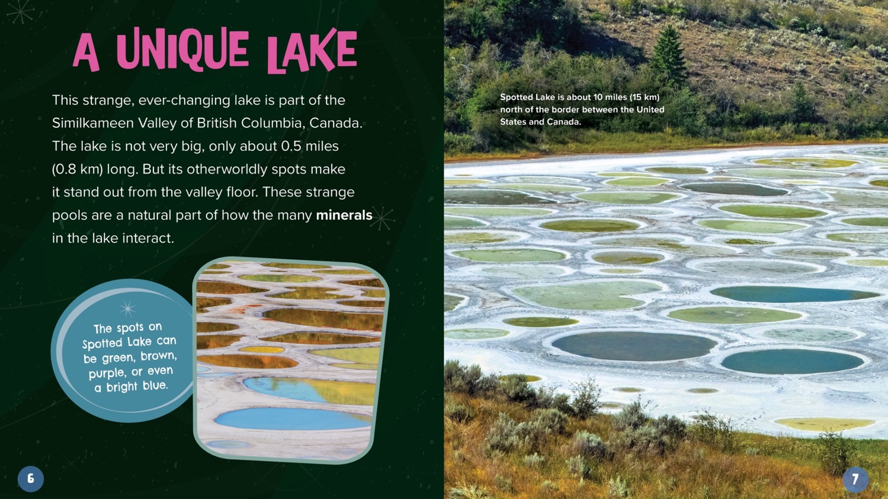
Notes:
SERIES SPREAD 1 - BEARPORT

Slide 84
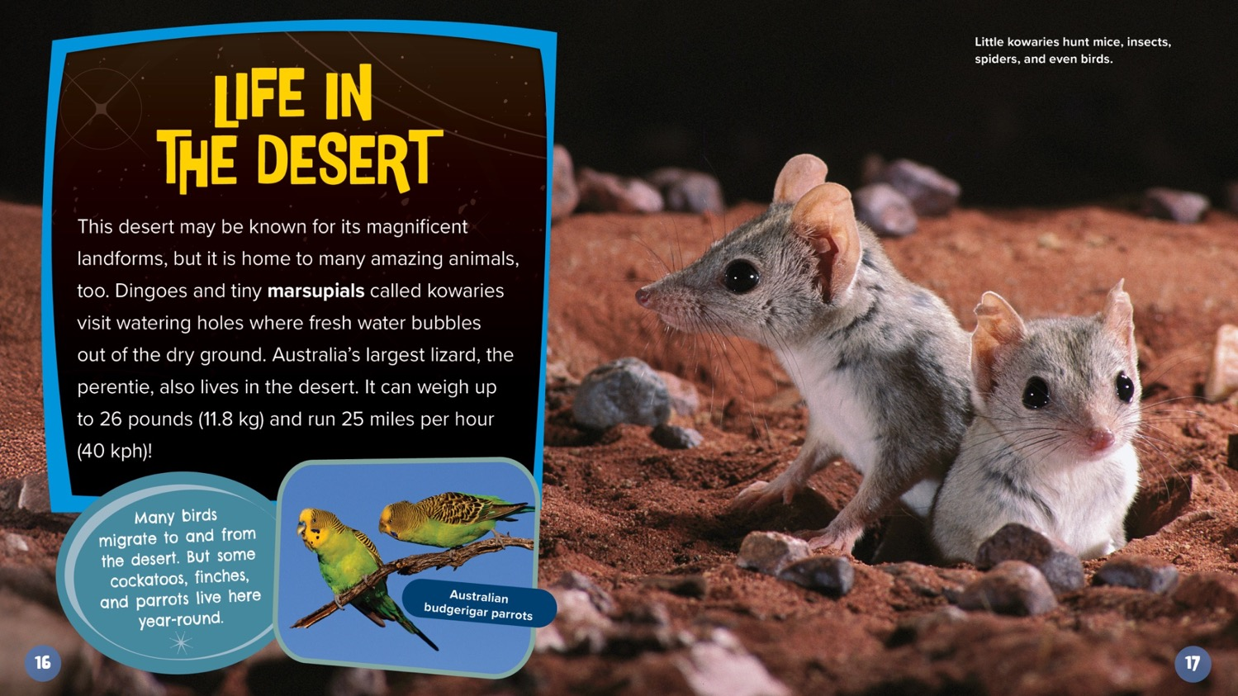
Notes:
SERIES SPREAD 2 - BEARPORT

Slide 85







POLLINATOR POWER!
New Series!
• ATOS: N/A
• Lexile: TBD
• Stunning macro photography
• Accessible language
• Meets NGSS standards on plant-pollinator
relationships
READING LEVEL: Gr. 3 • INTEREST LEVEL: Gr. 2-4
Notes:
SERIES COVERS - BELLWETHER

Slide 86

Notes:
SERIES SPREAD 1 - BEARPORT

Slide 87
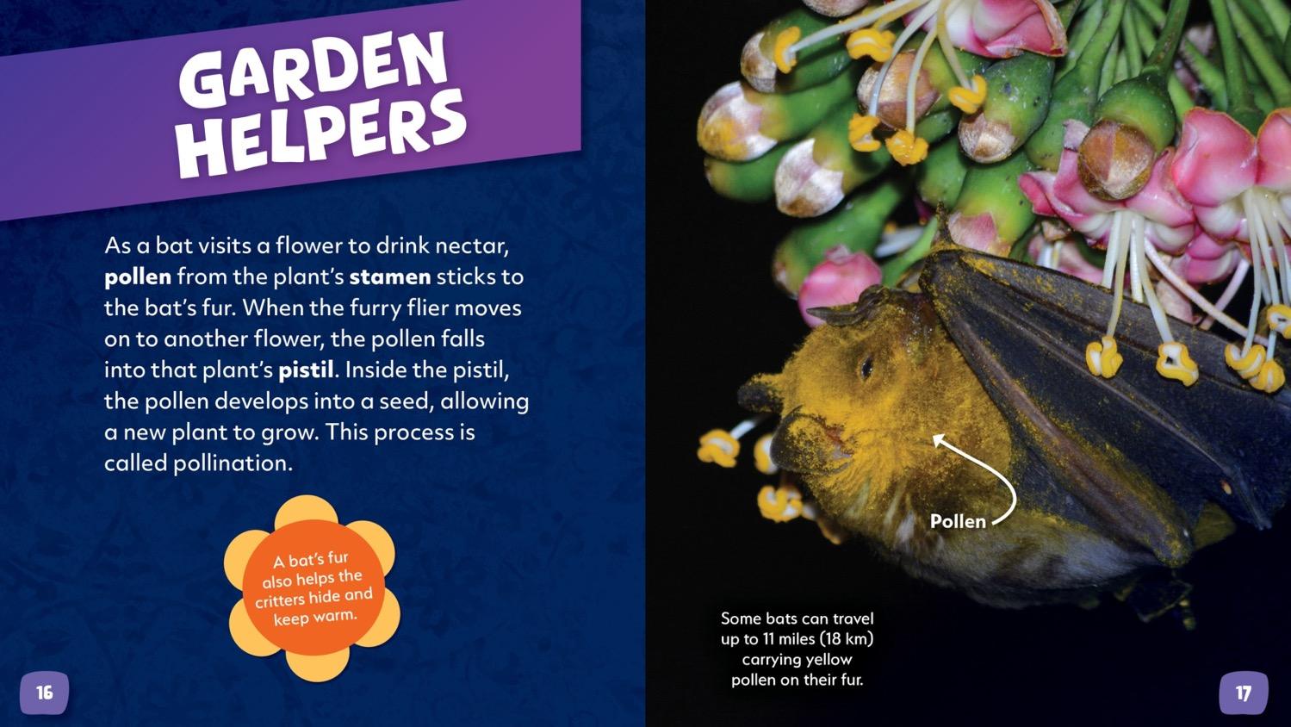
Notes:
SERIES SPREAD 2 - BEARPORT

Slide 88
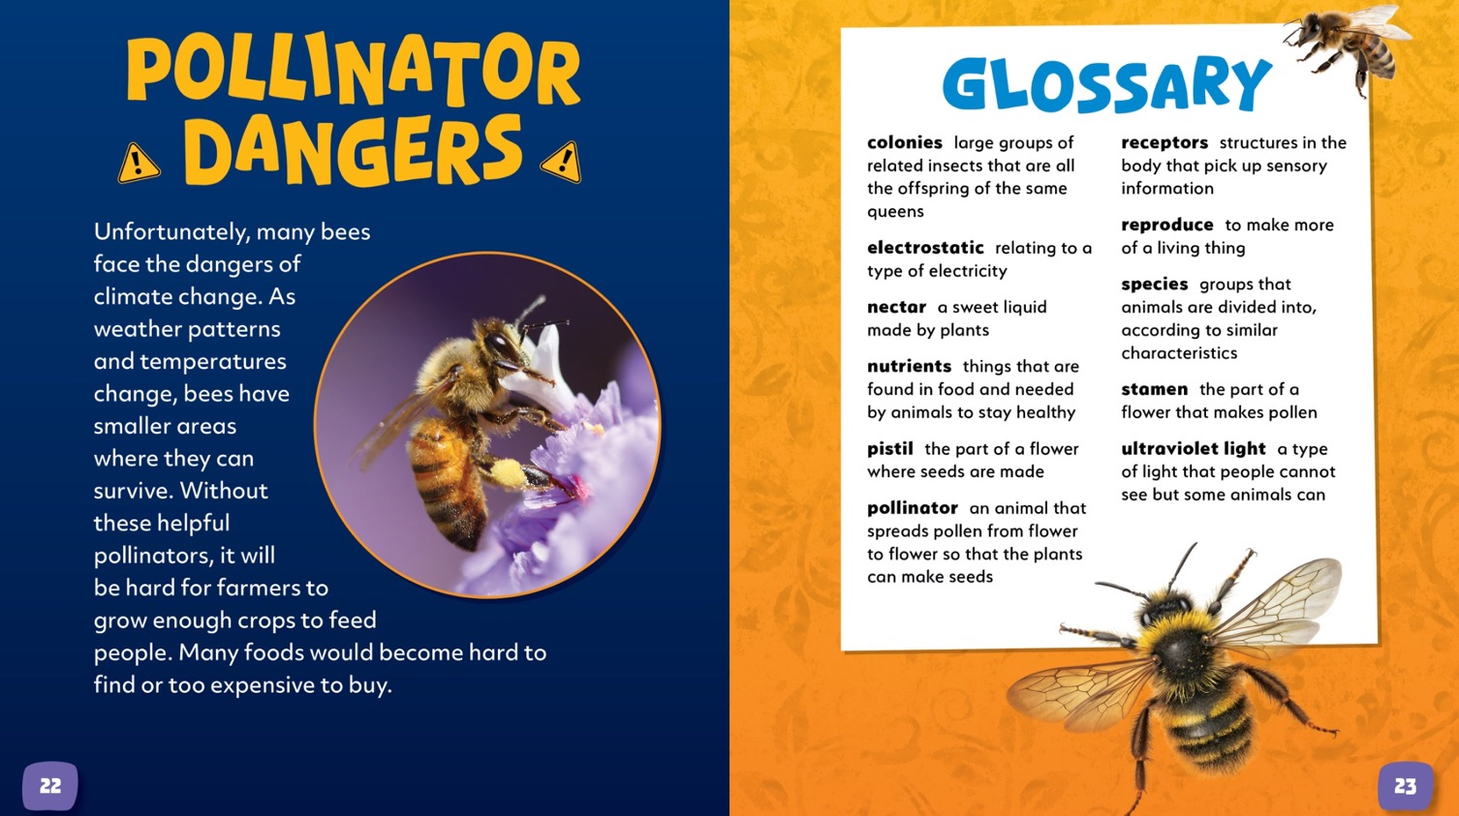
Notes:
SERIES SPREAD 2 - BEARPORT

Slide 89







UNDERWATER ODDITIES
New Series!
• ATOS: TBD
• Lexile: TBD
• Photos of unbelievable
ocean animals
• Features introduce real
marine biologists and their
scientific contributions
READING LEVEL: Gr. 3
INTEREST LEVEL: Gr. 2-4
Notes:
SERIES COVERS - BELLWETHER

Slide 90

Notes:
SERIES SPREAD 1 - BEARPORT

Slide 91

Notes:
SERIES SPREAD 1 - BEARPORT

Slide 92

Notes:
SERIES SPREAD 1 - BEARPORT

Slide 93


HI-LO
Reading Levels: Grades 1-4
Interest Level: Grades 3-7
ATOS Range: 3.0-5.0
Lexile Range: 530-800
Pages: 24
Hardcover: $21.67
Ebook: $19.99
Paperback: $7.99
Notes:
IMPRINT INTRO - BELLWETHER

Slide 94










POP CULTURE PERSONALITIES
New Series!
• ATOS: TBD
• Lexile: TBD
• Hi-Lo biographies on some of
the biggest stars of our time
READING LEVEL: Gr. 1-2
INTEREST LEVEL: Gr. 3-5
Notes:
SERIES COVERS - BELLWETHER

Slide 95

Notes:
SERIES SPREAD 1 - BEARPORT

Slide 96

Notes:
SERIES SPREAD 1 - BEARPORT

Slide 97






MYSTERIES TO EXPLORE
New Series!
• ATOS: N/A
• Lexile: TBD
• Explore the facts and theories
surrounding unusual events in history
• Excellent gateway to nonfiction
READING LEVEL: Gr. 2-3
INTEREST LEVEL: Gr. 5-6
?
?
?
?
?
?
?
?
?
?
?
Notes:
SERIES COVERS - BELLWETHER

Slide 98

Notes:
SERIES SPREAD 1 - BEARPORT

Slide 99

Notes:
SERIES SPREAD 1 - BEARPORT

Slide 100








A WORLD OF GODS
New Series!
• ATOS: N/A
• Lexile: TBD
• Perfect for middle-grade
mythology fans
• Connects with cultural
history and ancient
civilizations
READING LEVEL: Gr. 3-4
INTEREST LEVEL: Gr. 6-7
Notes:
SERIES COVERS - BELLWETHER

Slide 101

Notes:
SERIES SPREAD 1 - BEARPORT

Slide 102

Notes:
SERIES SPREAD 1 - BEARPORT

Slide 103


CURRICULAR HI-LO
Dyslexia-friendly font
Review sections & test-taking tips
Reading Level: Grade 3
Interest Level: Grades 5-7
Pages: 32
ATOS Range: 4.5-5.0
Lexile Range: 530-760
Hardcover: $23.07
Ebook: $19.99
Paperback: $7.99
Notes:
IMPRINT INTRO - BELLWETHER

Slide 104










FORMS OF GOVERNMENT: NEED TO KNOW
New Series!
• ATOS: N/A
• Lexile: TBD
• Approachable look at different
forms of government
• Infographics enhance
understanding of government
structures and history
READING LEVEL: Gr. 3
INTEREST LEVEL: Gr. 5-7
Notes:
SERIES COVERS - BELLWETHER

Slide 105

Notes:
SERIES SPREAD 1 - BEARPORT

Slide 106

Notes:
SERIES SPREAD 1 - BEARPORT

Slide 107







SPACE SCIENCE: NEED TO KNOW
New Series!
• ATOS: N/A
• Lexile: TBD
• Approachable look at key
science curriculum
• Infographics support
visual learning
READING LEVEL: Gr. 3
INTEREST LEVEL: Gr. 5-7
Notes:
SERIES COVERS - BELLWETHER

Slide 108

Notes:
SERIES SPREAD 1 - BEARPORT

Slide 109

Notes:
SERIES SPREAD 1 - BEARPORT

Slide 110


MIDDLE SCHOOL
Reading Level: Grade 6-7
Interest Level: Grades 5-8
Pages: 48
ATOS Range: 5.3-7.2
Lexile Range: 840-1170
Hardcover: $21.67
Ebook: $19.99
Paperback: $7.99
Notes:
IMPRINT INTRO - BELLWETHER

Slide 111








CHAOTIC WORLD
New Series!
• ATOS: N/A
• Lexile: TBD
• True stories with
archival photos
• Integrates history,
social studies, and STEM
• Introduces heroes who
rescued victims and
helps communities
recover after disasters
READING LEVEL: Gr. 6-7
INTEREST LEVEL: Gr. 5-8
Notes:
SERIES COVERS - BELLWETHER

Slide 112

Notes:
SERIES SPREAD 1 - BEARPORT

Slide 113

Notes:
SERIES SPREAD 1 - BEARPORT

Slide 114








PREHISTORIC LIFE
New Series!
• ATOS: N/A
• Lexile: TBD
• Covers fossil record and geologic time scale
• Encyclopedic format
• Review and Reflect feature
READING LEVEL: Gr. 6-7
INTEREST LEVEL: Gr. 5-8
Notes:
SERIES COVERS - BELLWETHER

Slide 115

Notes:
SERIES SPREAD 1 - BEARPORT

Slide 116

Notes:
SERIES SPREAD 1 - BEARPORT

Slide 117







ROCKS & FOSSILS
New Series!
• ATOS: N/A
• Lexile: TBD
• Covers rock cycle, minerals,
and fossil formation
• Review and Reflect Feature
READING LEVEL: Gr. 6-7
INTEREST LEVEL: Gr. 5-8
Notes:
SERIES COVERS - BELLWETHER

Slide 118

Notes:
SERIES SPREAD 1 - BEARPORT

Slide 119

Notes:
SERIES SPREAD 1 - BEARPORT

Slide 120



SPRING 2026
Presented by the editorial staff
Notes:
PUBLISHER INTRO - JUMP

Slide 121


BEGINNING READERS
Reading Level: Grades PreK-K
Interest Level: Grades PreK-1
ATOS Range: 0.5-0.9
Lexile Range: BR20-170L
Pages: 16
Hardcover: $20.29
Ebook: $19.99
Paperback: $7.99
Notes:
IMPRINT INTRO - BELLWETHER

Slide 122








LET’S LOOK AT FOOD GROUPS!
New Series!
• Table of Contents
• Teaching Tools for Caregivers
• Words to Know & Index
• Let’s Review! Section
READING LEVEL: Gr. PreK
INTEREST LEVEL: Gr PreK-1
Notes:
SERIES COVERS - BELLWETHER

Slide 123

Notes:
SERIES SPREAD 1 - BEARPORT

Slide 124

Notes:
SERIES SPREAD 1 - BEARPORT

Slide 125










MACHINES ON THE MOVE
8 New Titles!
• ATOS: N/A
• Lexile: TBD
• FEATURE FEATURE
FEATURE
• Table of contents,
index, Let’s Review!
section
READING LEVEL: Gr. PreK
INTEREST LEVEL: Gr PreK-1
Notes:
SERIES COVERS - BELLWETHER

Slide 126

Notes:
SERIES SPREAD 1 - BEARPORT

Slide 127

EARLY READERS AND BEGINNING CONCEPTS
Reading Level: Grade K
Interest Level: Grades K-3
ATOS Range: 0.5-1.5
Lexile: 100L-400L
Pages: 24
Hardcover: $20.99
Ebook: $19.99
Paperback: $7.99
Notes:
IMPRINT INTRO - BELLWETHER

Slide 128








WHITE HOUSE PETS
New Series!
• Real photos of first families with their pets
• Picture Glossary + photo labels
• Visual graphics
• Perfect for observing
America’s Semiquincentennial
(250th anniversary)
READING LEVEL: Gr. K
INTEREST LEVEL: Gr. K-3
Notes:
SERIES COVERS - BELLWETHER

Slide 129

Notes:
SERIES SPREAD 1 - BEARPORT

Slide 130

Notes:
SERIES SPREAD 2 - BEARPORT

Slide 131






BAT BUDDIES
New Series!
• Picture Glossary
• Body part labels
• Range maps show where
bats live
READING LEVEL: Gr. K
INTEREST LEVEL: Gr. K-3
Notes:
SERIES COVERS - BELLWETHER

Slide 132

Notes:
SERIES SPREAD 1 - BEARPORT

Slide 133

Notes:
SERIES SPREAD 2 - BEARPORT

Slide 134







HELLO, INSECTS!
New Series!
• Table of Contents + Index
• Picture Glossary + labels
• Details about insects’
behaviors and habitats
• Labeled body diagrams
READING LEVEL: Gr. K
INTEREST LEVEL: Gr. K-3
Notes:
SERIES COVERS - BELLWETHER

Slide 135

Notes:
SERIES SPREAD 1 - BEARPORT

Slide 136

Notes:
SERIES SPREAD 2 - BEARPORT

Slide 137






MEET THE HORSES
6 New Titles
Also in
Spanish!
• Picture Glossary + labels
• Labeled diagrams
highlight each breed’s
features
• Table of Contents + Index
READING LEVEL: Gr. K
INTEREST LEVEL: Gr. K-3
Notes:
SERIES COVERS - BELLWETHER

Slide 138

Notes:
SERIES SPREAD 1 - BEARPORT

Slide 139

Notes:
SERIES SPREAD 2 - BEARPORT

Slide 140






VROOM!
6 New Titles
Also in
Spanish!
• Picture Glossary + labels
• Maps
• Details and history of
features, logo, and models
• Car name pronunciations
READING LEVEL: Gr. K
INTEREST LEVEL: Gr. K-3
Notes:
SERIES COVERS - BELLWETHER

Slide 141

Notes:
SERIES SPREAD 1 - BEARPORT

Slide 142

Notes:
SERIES SPREAD 2 - BEARPORT

Slide 143



ILLUSTRATED FICTION & NARRATIVE NONFICTION
Reading Levels:
Level 1: Grades PreK-K
Level 2: Grade 1
Level 3: Grade 2
Interest Level: Grades PreK-5
ATOS Range: 0.5-3.5
Lexile Range: 230L-560L
Pages: 16-24
Hardcover: $20.99
Ebook: $19.99
Paperback: $7.99
Notes:
IMPRINT INTRO - BELLWETHER

Slide 144






FAIRY TALE PHONICS Level 1
4 New Titles
• Fun storylines
• Introduce early phonics
concepts, including word
families and letter blends
• Let’s Review! feature
reinforces content
• Picture Glossary
READING LEVEL: Gr. PreK-K
INTEREST LEVEL: Gr. PreK-2
Notes:
SERIES COVERS - BELLWETHER

Slide 145

Notes:
SERIES SPREAD 1 - BEARPORT

Slide 146

Notes:
SERIES SPREAD 2 - BEARPORT

Slide 147








LEARNING LIFE SKILLS WITH MYTHICAL CREATURES
Level 2
New Series!
• Fun, relatable storylines
• SEL connections
• Let’s Review! section reinforces content
READING LEVEL: Gr. 1
INTEREST LEVEL: Gr. 1-2
Notes:
SERIES COVERS - BELLWETHER

Slide 148

Notes:
SERIES SPREAD 1 - BEARPORT

Slide 149

Notes:
SERIES SPREAD 2 - BEARPORT

Slide 150

Notes:
SERIES SPREAD 2 - BEARPORT

Slide 151






ADVENTURERS IN HISTORY
Level 3
4
New Titles
• Action-packed Biographies
• Fun, detailed illustrations
• Timelines
• Maps
• Glossary + Index
READING LEVEL: Gr. 2
INTEREST LEVEL: Gr. 2-5
Notes:
SERIES COVERS - BELLWETHER

Slide 152

Notes:
SERIES SPREAD 1 - BEARPORT

Slide 153

Notes:
SERIES SPREAD 2 - BEARPORT

Slide 154

Notes:
SERIES SPREAD 2 - BEARPORT

Slide 155


KNOWLEDGE BUILDING
STEM & Social Studies Topics
Reading Level: Grade 2
Interest Level: Grades 2-5
ATOS Range: 2.5-3.5
Lexile Range: 350-560L
Pages: 24
Hardcover: $20.99
Ebook: $19.99
Paperback: $7.99
Notes:
IMPRINT INTRO - BELLWETHER

Slide 156









AMERICAN HEROES
New Series!
• What Do You Think? sidebars
• Timelines
• Perfect for observing America’s
Semiquincentennial (250th
anniversary)
• Alice Wong co-authored her book
• Take a Look! infographics
READING LEVEL: Gr. 2
INTEREST LEVEL: Gr. 2-5
Notes:
SERIES COVERS - BELLWETHER

Slide 157

Notes:
SERIES SPREAD 1 - BEARPORT

Slide 158


Slide 159


Slide 160







WRITING THAT CHANGED U.S. HISTORY
New Series!
• Take a Look! infographics
• Timelines
• Perfect for observing America’s
Semiquincentennial (250th
anniversary)
• What Do You Think? Sidebars
encourage deeper inquiry
READING LEVEL: Gr. 2
INTEREST LEVEL: Gr. 2-5

Slide 161


Slide 162


Slide 163


Slide 164










EXPLORING THE SENSES
New Series!
• Photo labels + diagrams
• STEM sidebars
• Take a Look! infographics
• Try This! STEM activities
READING LEVEL: Gr. 2
INTEREST LEVEL: Gr. 2-5

Slide 165


Slide 166


Slide 167





SPRING 2026
Presented by
The editorial staff
Notes:
PUBLISHER INTRO - KALEIDOSCOPE

Slide 168



GRAPHIC NOVELS
Reading Level: Grades 1-3
Interest Level: Grades 1-3
ATOS Range: 2.5-3.5
Lexile Range: 480-550
Pages: 32-64
Hardcover: $21.67-$23.07
Ebook: $19.99
Paperback: $9.99-$10.99
Notes:
IMPRINT INTRO - KALEIDOSCOPE

Slide 169




APOCALYPSE GRAN
GRAPHIC NOVELS
READING LEVEL: Gr. 1-2
INTEREST LEVEL: Gr. K-3
• Hilarious tales of grandma and grandson
navigating a robot apocalypse
• Tackles themes of loyalty, responsibility, and
family dynamics
• Appeals to fans of absurd comic humor
Notes:
SERIES COVERS - KALEIDOSCOPE

Slide 170

Notes:
SERIES SPREAD 1 - KALEIDOSCOPE

Slide 171

Notes:
SERIES SPREAD 2 - KALEIDOSCOPE
**Note: Will need at least one more spread for each series.

Slide 172

Notes:
SERIES SPREAD 2 - KALEIDOSCOPE
**Note: Will need at least one more spread for each series.

Slide 173




SUPER DWEEB
• ATOS Range: TBD
• Lexile Range: TBD
• Perfect for fans of
Captain Underpants and
Diary of a Wimpy Kid
New
Title
GRAPHIC NOVELS
READING LEVEL: Gr. 1-2
INTEREST LEVEL: Gr. K-3

Slide 174


Slide 175


Slide 176


Slide 177


PICTURE BOOKS
Reading Level: Grades 1-2
Interest Level: Grades K-3
ATOS Range: 2.5-3.5
Lexile Range: 480-550
Pages: 32
Hardcover: $21.67
Ebook: $19.99
Paperback: $9.99
Notes:
IMPRINT INTRO - BELLWETHER

Slide 178







PICTURE POEMS
4
New Titles
• ATOS Range: N/A
• Lexile Range: TBD
• Poetry gives voice to complex feelings
• Meets ELA standards for poetry in grades 1-2
PICTURE BOOKS
READING LEVEL: Gr. 1-2
INTEREST LEVEL: Gr. K-3

Slide 179


Slide 180








PUNS OF FUN
2
New Titles
• ATOS Range: TBD
• Lexile Range: TBD
• Early life skills such as
Perseverance,
self-confidence, and
understanding differences
• Back matter includes
activity to make your own pun
PICTURE BOOKS
READING LEVEL: Gr. 1-2
INTEREST LEVEL: Gr. K-3

Slide 181


Slide 182






CHAPTER BOOKS
Reading Level: Grades K-4
Interest Level: Grades K-5
ATOS Range: 2.7-4.2
Lexile Range: 520-730
Pages: 32-128
Hardcover: $23.07
Ebook: $19.99
Paperback: $10.99
Notes:
IMPRINT INTRO - BELLWETHER

Slide 183








BIGFOOT ADVENTURES
6
New Titles
• ATOS Range: N/A
• Lexile Range: TBD
• Fiction story paired with
nonfiction sidebars
• Interactive scavenger hunt
throughout
CHAPTER BOOKS
READING LEVEL: Gr. 1-2
INTEREST LEVEL: Gr. K-3

Slide 184


Slide 185


Slide 186



Charlie’s Animal Park
2
New Titles
• ATOS Range: TBD
• Lexile Range: TBD
• Funny, fantastical
adventures featuring
zoo animals
• Focus on family
relationships
CHAPTER BOOKS
READING LEVEL: Gr. 1-2
INTEREST LEVEL: Gr. K-3

Slide 187


Slide 188









SADIE:
SUPERSTAR BAKER
New Series
• ATOS Range: N/A
• Lexile Range: TBD
• Fun, relatable stories
• Diverse characters and situations
• Back matter includes recipes
CHAPTER BOOKS
READING LEVEL: Gr. 2-3
INTEREST LEVEL: Gr. K-3

Slide 189


Slide 190


Slide 191


Slide 192







MY SECRET MYTHICAL FRIEND
New Series
• ATOS Range: TBD
• Lexile Range: TBD
• Ever-popular unicorns,
yetis, mermaids, and other
magical creatures
• Tackles themes of honesty
and loyalty
CHAPTER BOOKS
READING LEVEL: Gr. 3-4
INTEREST LEVEL: Gr. 2-5

Slide 193


Slide 194


Slide 195





JORDAN JONES SPORTS
4
New Titles
• ATOS Range: N/A
• Lexile Range: TBD
• Explores themes of teamwork,
bullying, fitting in, and equity
• Back matter includes profiles
of real athletes, discussion
questions, and writing prompts
CHAPTER BOOKS
READING LEVEL: Gr. 3-4
INTEREST LEVEL: Gr. 2-5

Slide 196


Slide 197




DAISY DOLITTLE: ANIMAL DETECTIVE
2
New Titles
• FEATURE FEATURE FEATURE
• FEATURE FEATURE FEATURE
• FEATURE FEATURE FEATURE
CHAPTER BOOKS
READING LEVEL: Gr. 3-4
INTEREST LEVEL: Gr. 2-5

Slide 198


Slide 199


Slide 200



DINO QUEST
2
New Titles
• ATOS Range: N/A
• Lexile Range: TBD
• High-interest appeal
of dinosaurs and
medieval knights
• Themes of destiny
and rising to
challenges
CHAPTER BOOKS
READING LEVEL: Gr. 3-4
INTEREST LEVEL: Gr. 2-5

Slide 201


Slide 202







MOONLIGHT MAGIC CLUB
New Series
• ATOS Range: TBD
• Lexile Range: TBD
• Diverse characters and
situations
• High-interest of magic
paired with everyday
dilemmas
• Themes of friendship,
bravery, and
perseverance
CHAPTER BOOKS
READING LEVEL: Gr. 3-4
INTEREST LEVEL: Gr. 2-5

Slide 203


Slide 204


Slide 205



New Series
• ATOS Range: N/A
• Lexile Range: TBD
• Features strong Black
female protagonist
• Deals with themes of
family pressure and
finding your place in
the world
CHAPTER BOOKS
READING LEVEL: Gr. 4-5
INTEREST LEVEL: Gr. 3-8

Slide 206


Slide 207


Slide 208


EXPANDED NONFICTION
TWIST OF FICTION AND NONFICTION
Reading Level: Grades 3-4
Interest Level: Grades 2-5
ATOS Range: TBD
Lexile Range: 480-860
Pages: 48
Hardcover: $22.37-$23.07
Ebook: $19.99
Paperback:$10.99
Notes:
IMPRINT INTRO - BELLWETHER

Slide 209










New Series
• ATOS Range: N/A
• Lexile Range: TBD
• Joke books get kids excited
about reading
• Safe jokes for young
audiences
EXPANDED NONFICTION
READING LEVEL: Gr. 3-4
INTEREST LEVEL: Gr. 2-5

Slide 210


Slide 211


Slide 212







SPORTS
ZINES
4
New Titles
• ATOS Range: N/A
• Lexile Range: TBD
• Engaging mix of fiction and nonfiction
• Sophisticated, browsable design
• Includes male and female pro sports
EXPANDED NONFICTION
READING LEVEL: Gr. 3-4
INTEREST LEVEL: Gr. 2-5

Slide 213


Slide 214


Slide 215


Slide 216


Slide 217

Questions, quotes or to see books by appointment:
Rick Beale, VA Representative
rbeale3@mac.com
804.337.8702 - Cell
P. O. Box 1545 / 318 N. Main St.
Bowling Green VA 22427
www.beale-educational.com

